Slide 1
System Bus

Slide 2
Outline
Bus arbitration
  Dynamic bus arbitration
  Implementation
    Centralized
    Distributed
Example buses
  ISA
  PCI
  AGP
  PCI-X
  PCMCIA
Introduction
Bus design issues
  Bus width
  Bus type
  Bus operations
Synchronous bus
  Bus operation
  Wait states
  Block transfer
Asynchronous bus

Slide 3
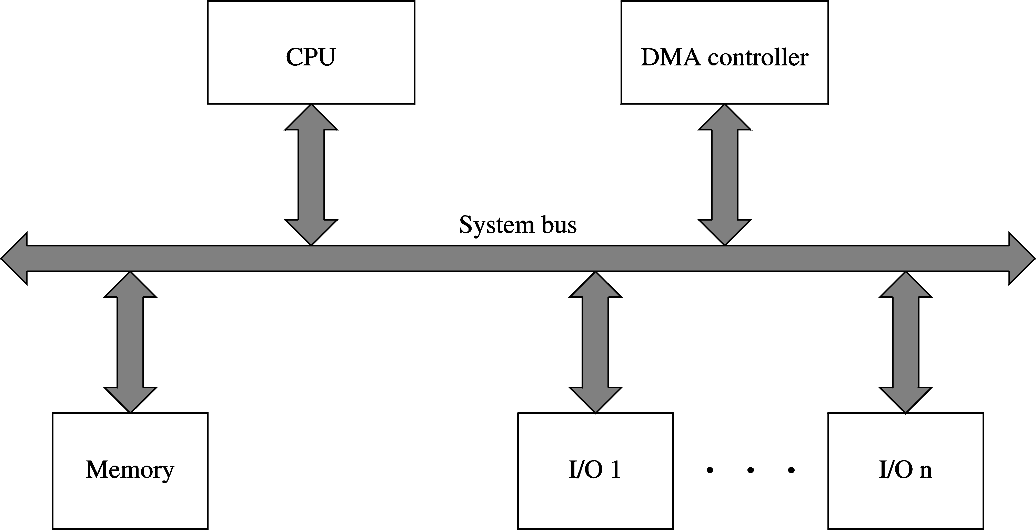
Introduction

Slide 4
System bus consists of
  Address bus
  Data bus
  Control bus
Buses can be
  Dedicated
  Multiplexed
  Synchronous
  Asynchronous

Slide 5
Introduction (cont’d)
Control bus
  Memory read and Memory write
  I/O read and I/O write
  Ready
  Bus request and Bus grant
  Interrupt and Interrupt acknowledgement
  DMA request and DMA acknowledgement
  Clock
  Reset

Slide 6
Bus Design Issues
Need to consider several design issues
  Bus width
    Data and address buses
  Bus type
    Dedicated or multiplexed
  Bus operations
    Read, write, block transfer, interrupt, …
  Bus arbitration
    Centralized or distributed
  Bus timing
    Synchronous or asynchronous

Slide 7
Data bus width
  A critical parameter in determining system performance
  Need not correspond to the ISA-specific value
    Pentium is a 32-bit processor
      But has 64-bit data bus
    Itanium is a 64-bit processor
      But has 128-bit data bus
  The wider the data bus, the better
    Wider buses are expensive

Slide 8
Address bus width
  Determines the system addressing capacity
  N address lines directly address 2^{N} memory locations
    8086: 20 address lines
      Could address 1 MB of memory
    Pentium: 32 address lines
      Could address 4 GB of memory
    Itanium: 64 address lines
      Could address 2⁶⁴ bytes of memory

Slide 9
Bus Type
Dedicated buses
  Separate buses dedicated to carry data and address information
  Good for performance
    But increases cost
Multiplexed buses
  Data and address information is time multiplexed on a shared bus
  Better utilization of buses
  Reduces cost

Slide 10
Bus Operations
Basic operations
  Read and write
Block transfer operations
  Read or write several contiguous memory locations
    Example: cache line fill
Read-modify-write operation
  Useful for critical sections
Interrupt operation
Several other types…

Slide 11
Synchronous Bus
A bus clock signal provides timing information for all actions
  Changes occur relative to the falling or rising edge of the clock
  Choosing appropriate clock is important
  Easier to implement
  Most buses are synchronous
Bus operations can be
  With no wait states, or
  With wait states

Slide 12
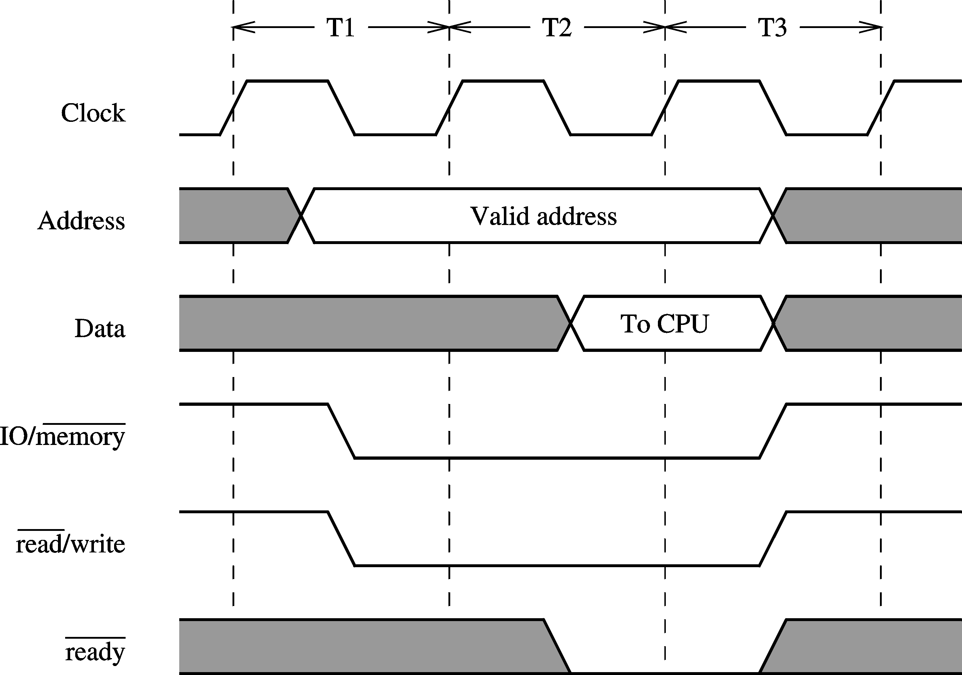
Synchronous Bus (cont’d)
Memory read operation with no wait states

Slide 13
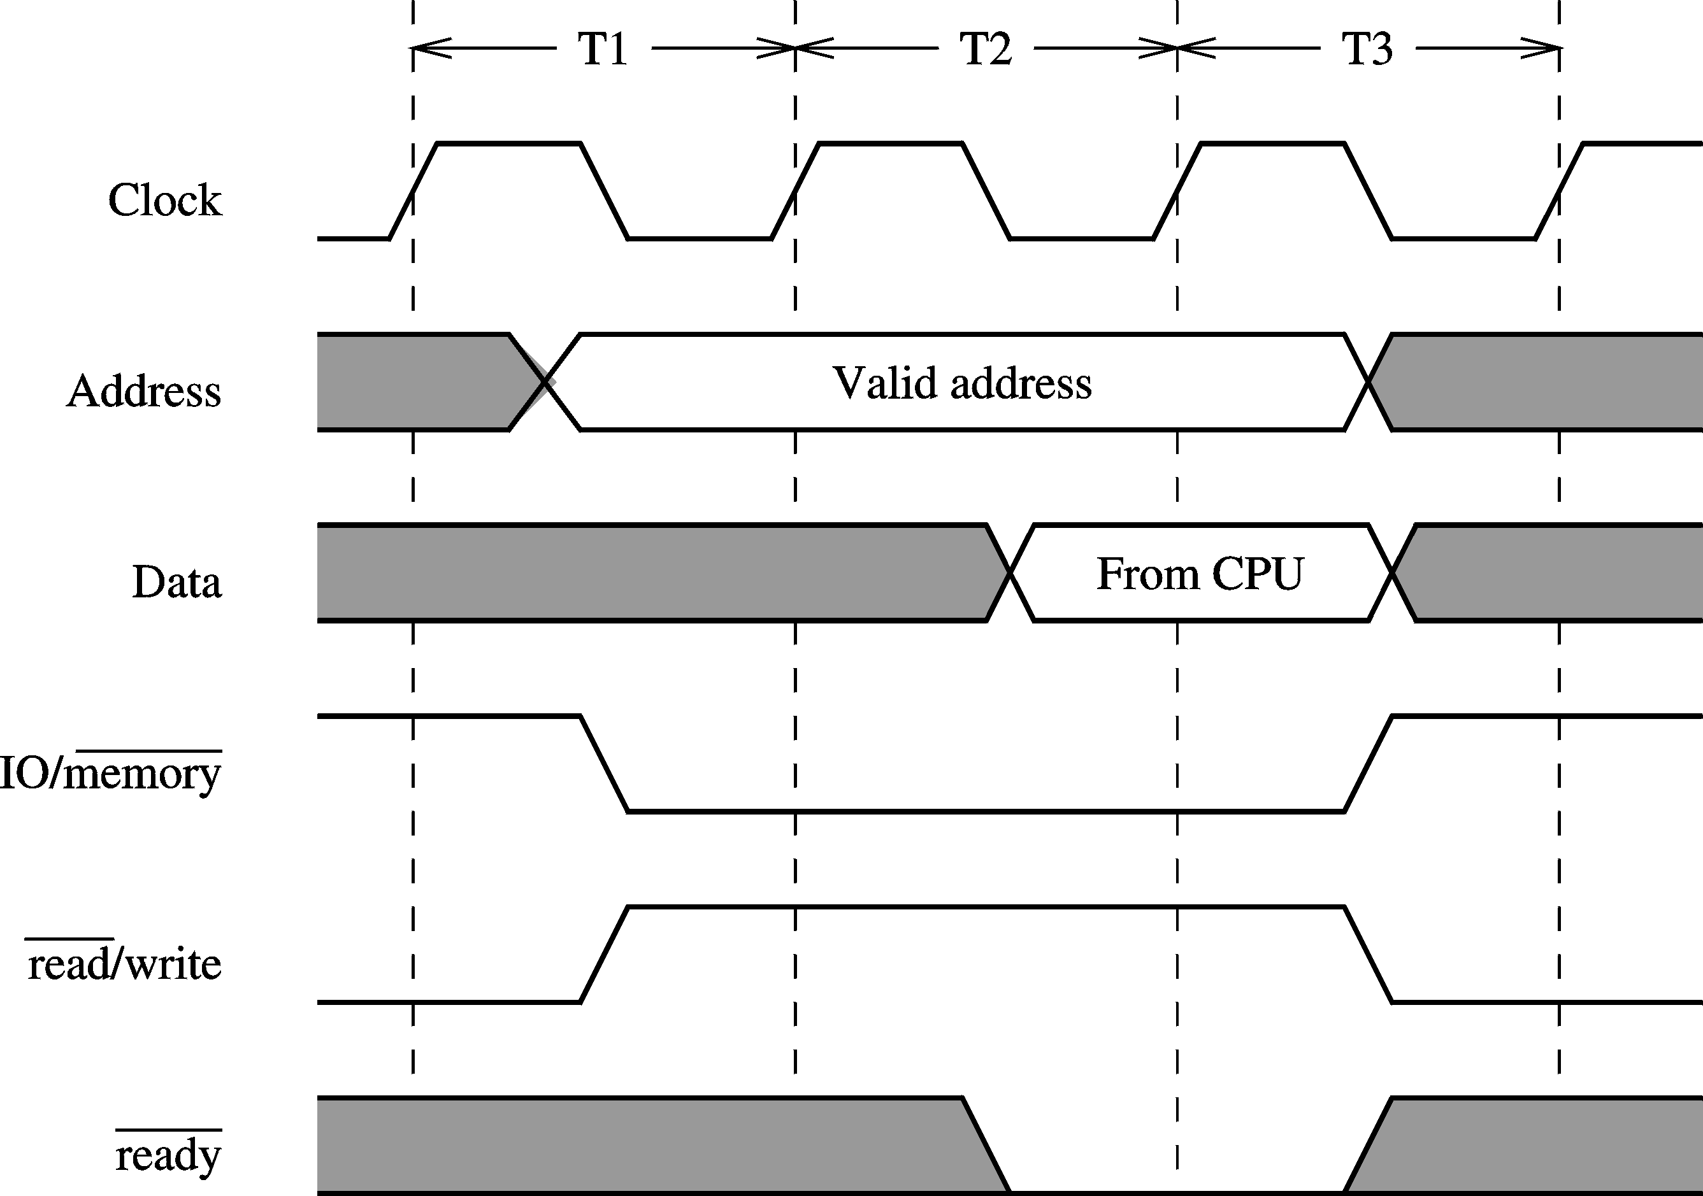
Synchronous Bus (cont’d)
Memory write operation with no wait states

Slide 14
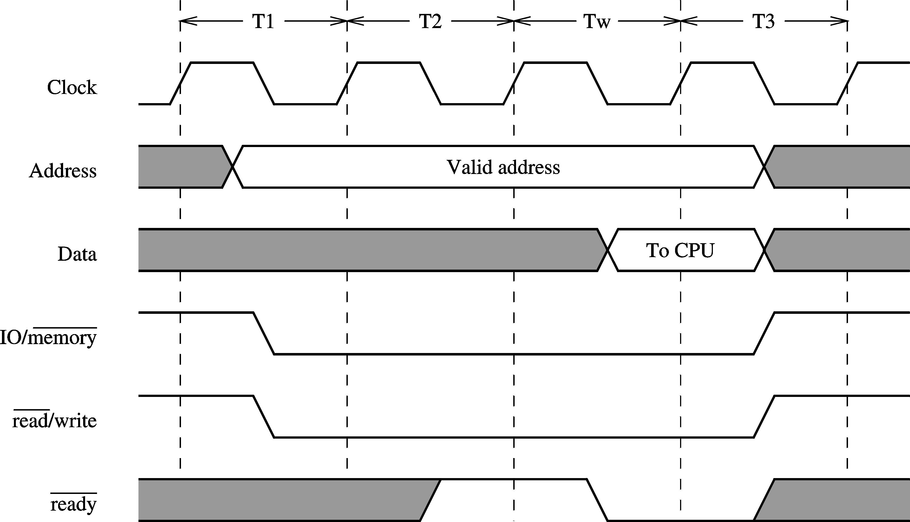
Synchronous Bus (cont’d)
Memory read operation with a wait state

Slide 15
Synchronous Bus (cont’d)
Memory write operation with a wait state

Slide 16
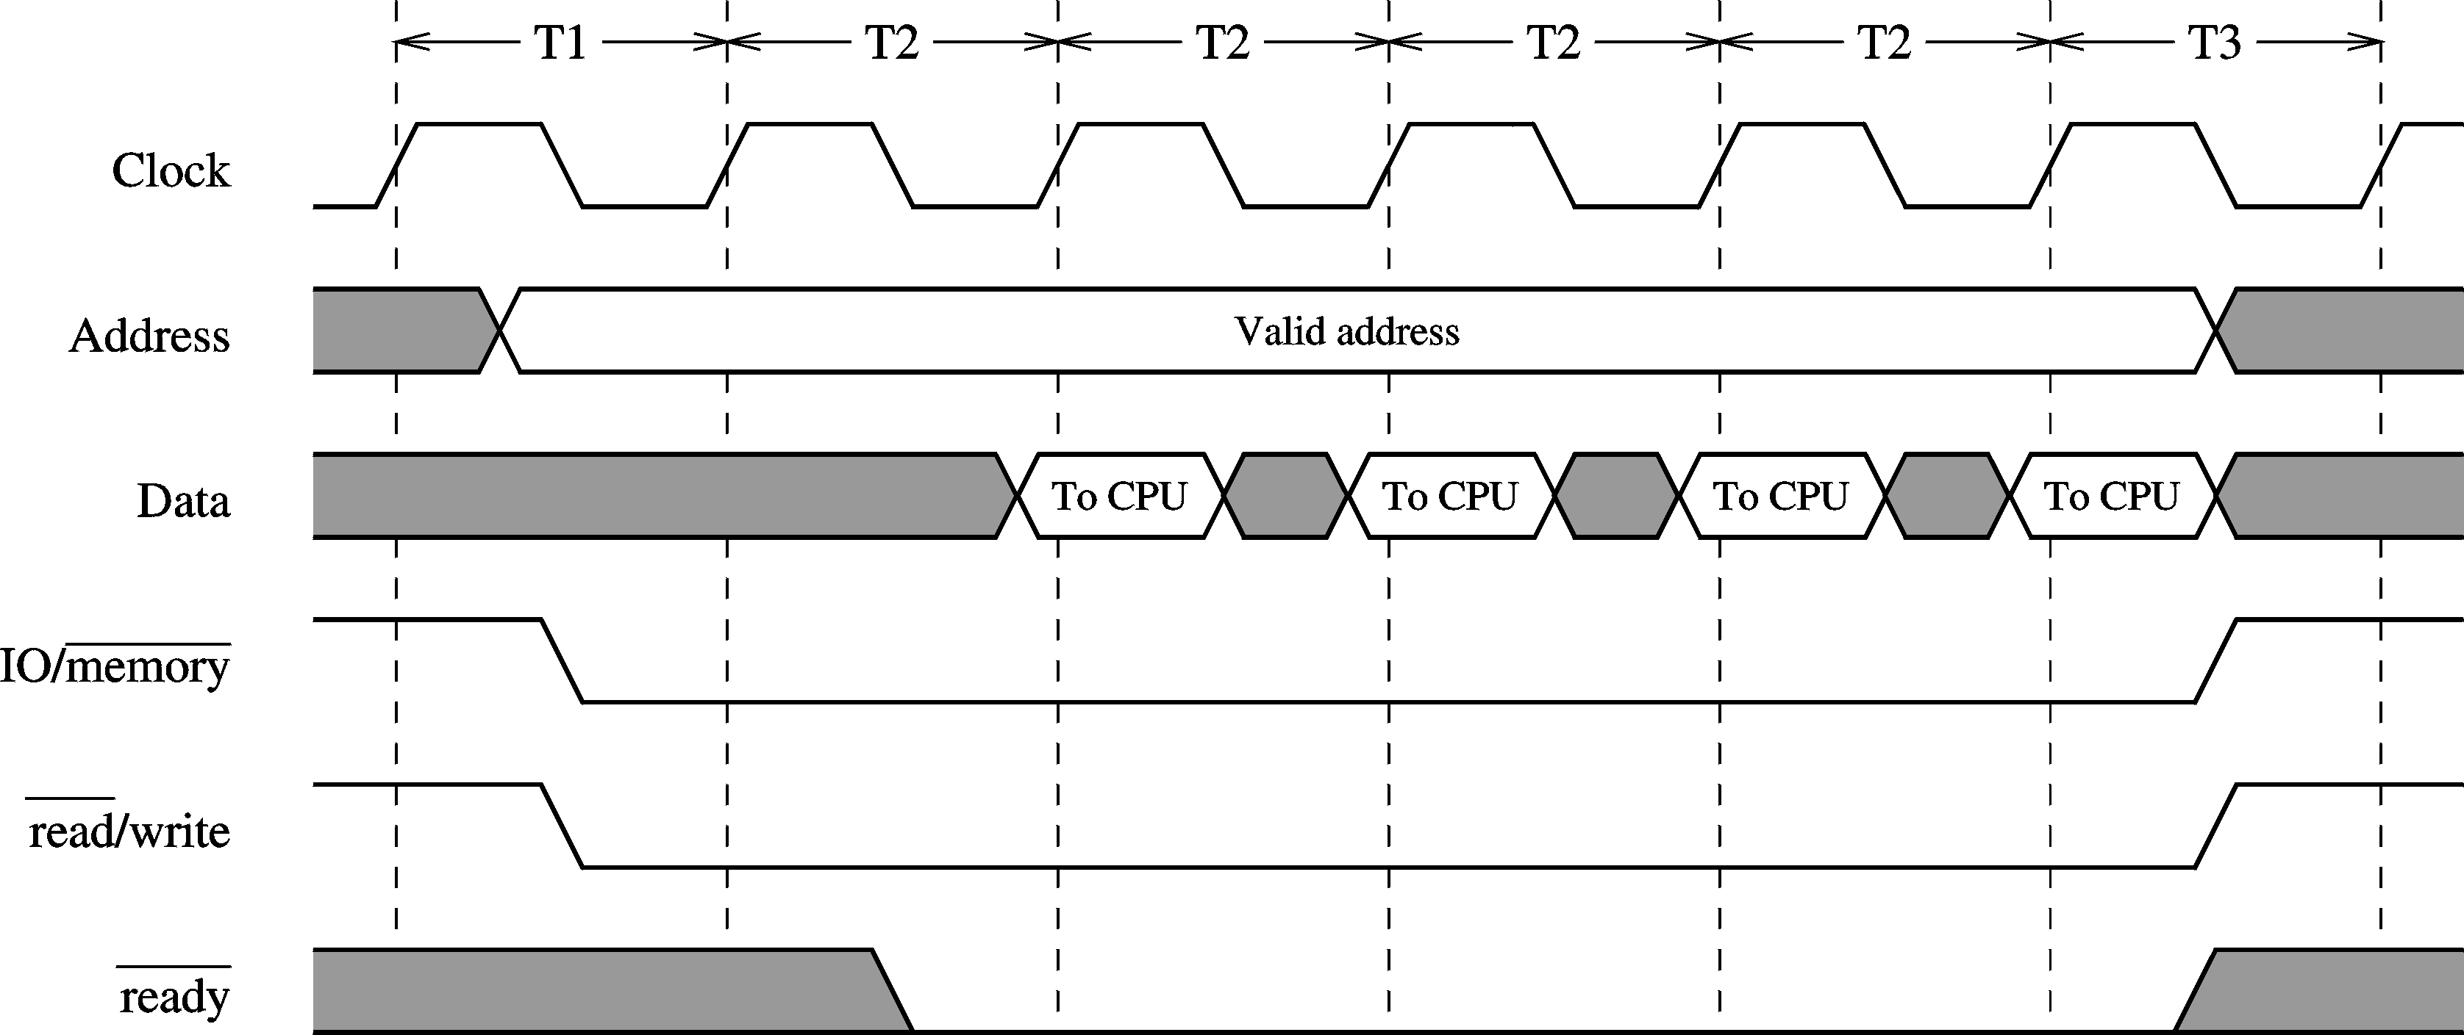
Synchronous Bus (cont’d)
Block transfer of data

Slide 17
Asynchronous Bus
No clock signal to synchronize actions
Operates in master-slave mode
Uses handshaking to perform a bus transaction
  Two synchronization signals facilitate this
    Master synchronization (MSYN)
    Slave synchronization (SSYN)
Advantage of asynchronous buses
    No need for bus clock
Synchronous buses
    Easier to implement

Slide 18
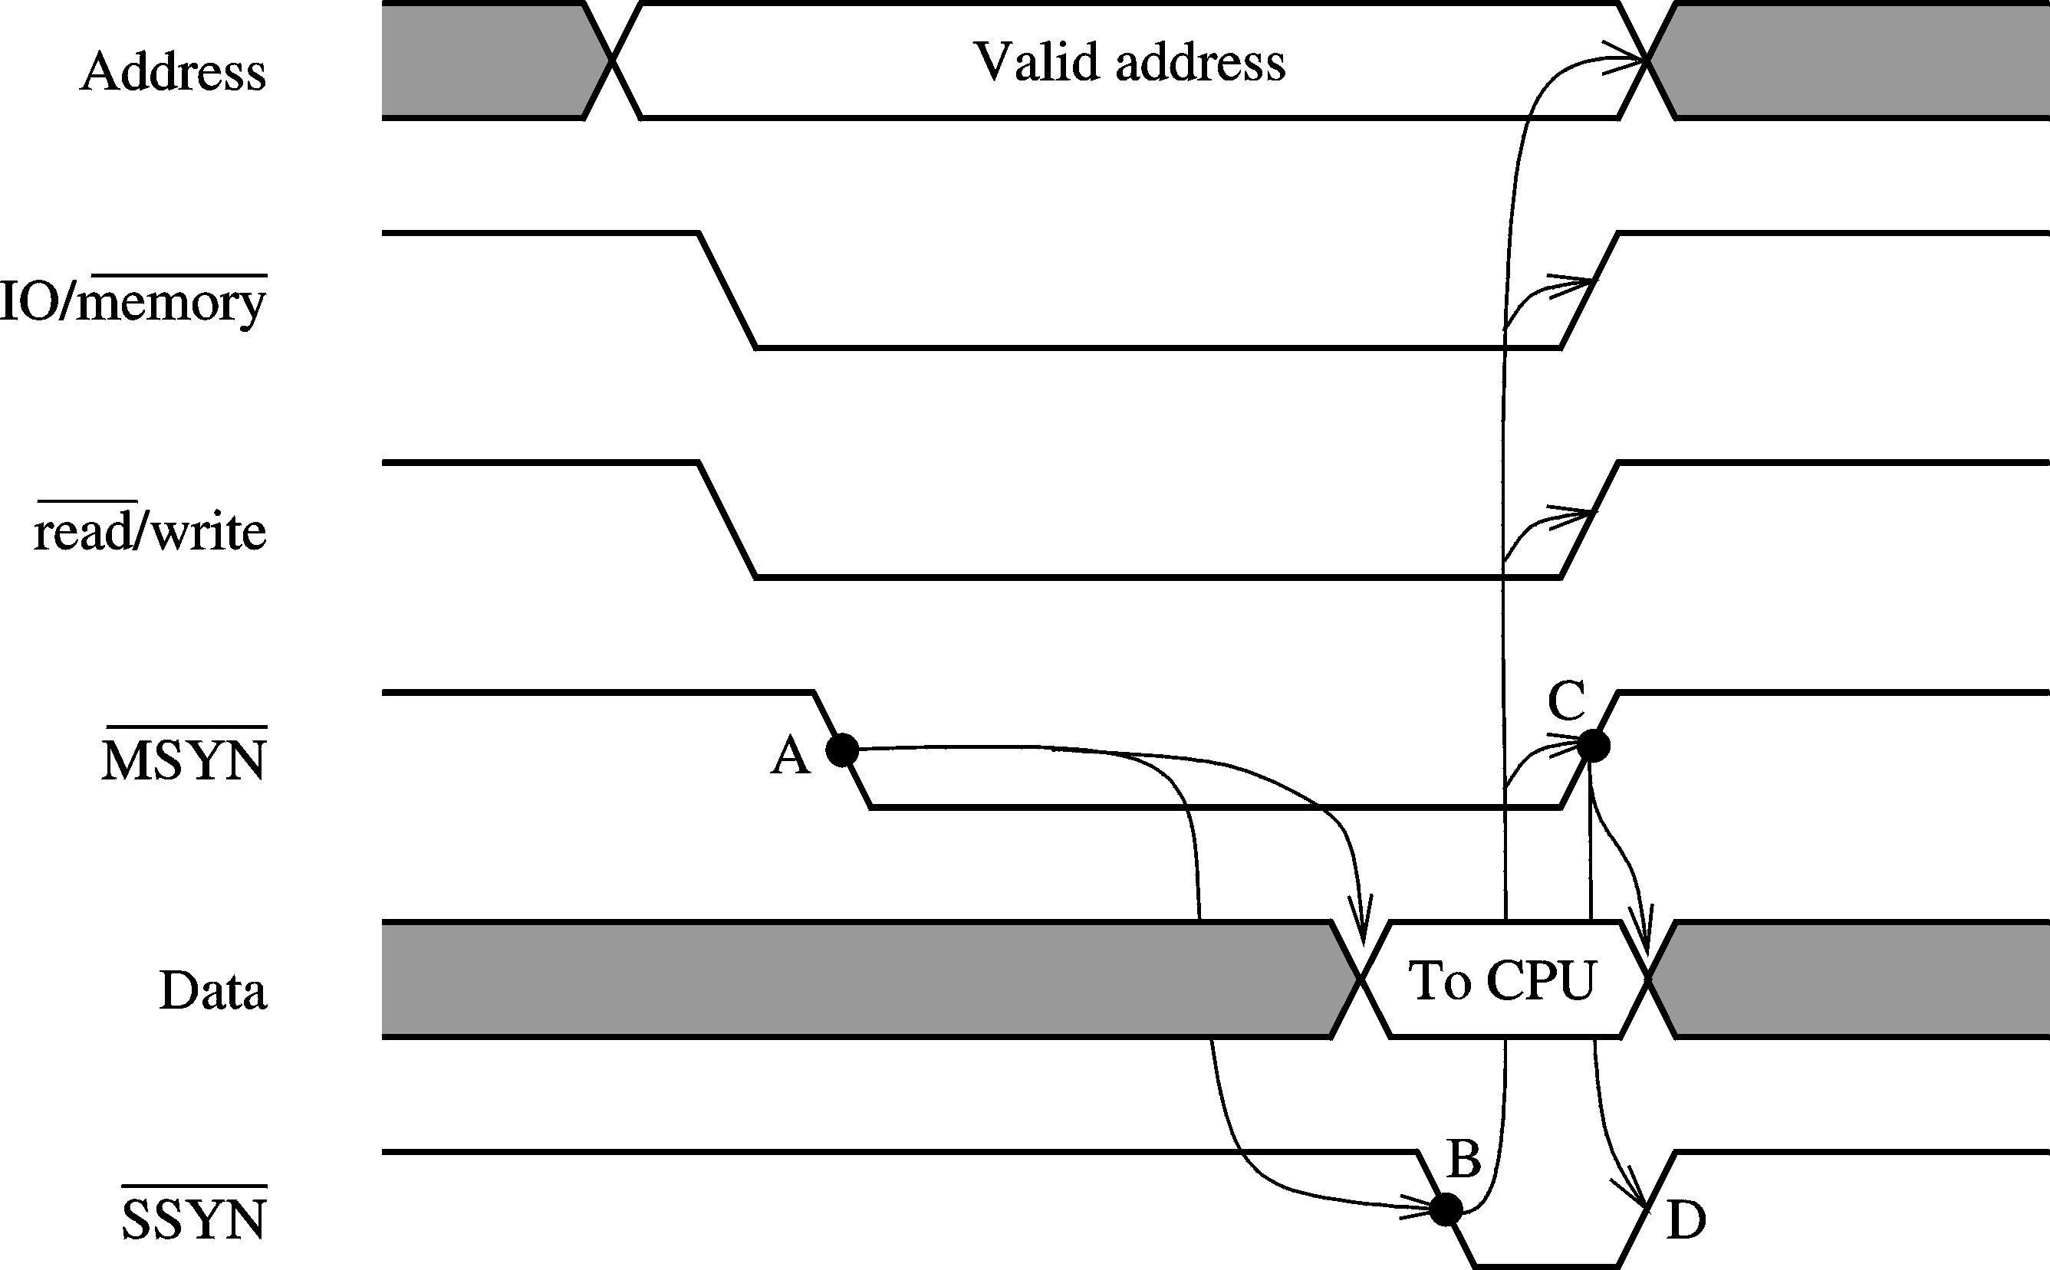
Asynchronous Bus (cont’d)

Slide 19
Bus Arbitration
More than one bus master can request the bus
  Need an arbitration mechanism to allocate the bus
Bus arbitration can be done either
  Statically
  Dynamically
Static arbitration
  Done in a predetermined way
    Easy to implement
    Does not take needs into account
    Poor utilization
      Bus could be assigned even when not needed

Slide 20
Dynamic Bus Arbitration
Bus allocated only in response to a request
Each master is equipped with
  Bus request line
  Bus grant line
A master uses the bus request line to let others know that it needs the bus
Before a master can use the bus, it must receive permission to use the bus via the bus grant line

Slide 21
Bus arbitration can be implemented
  Centralized
  Distributed
Centralized arbitration
    A central arbiter receives all bus requests
    Uses an allocation policy to determine which request should be granted
    This decision is conveyed through the bus grant lines
  Once the transaction is over, bus is released
    A bus release policy determines the actual release mechanism

Slide 22
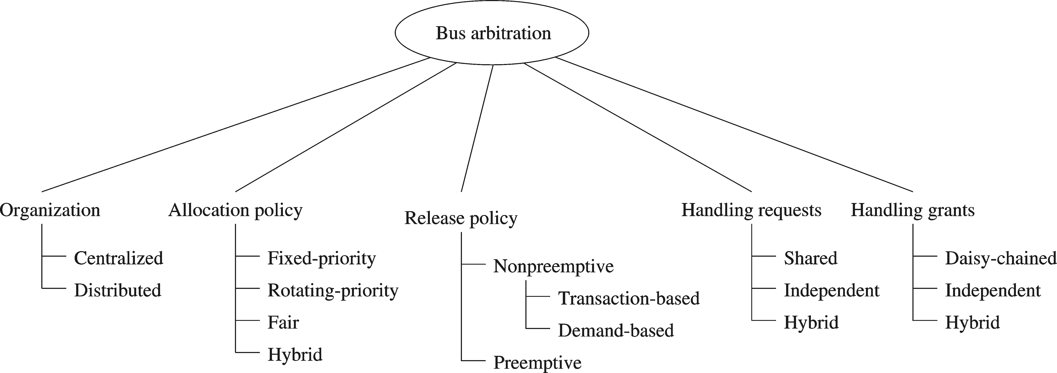
Distributed arbitration
  Arbitration hardware is distributed among the masters
  A distributed arbitration algorithm is used to determine who should get the bus

Slide 23
Bus Allocation Policies
  Fixed priority
    Each master is assigned a fixed priority
    Highest priority master always gets the bus
    Priorities can be assigned based on the importance of service
  Rotating priority
    Priority is not fixed
    Several ways of changing priority
      Increase the priority as a function of waiting time
      Lowest priority for the master that just received the bus

Slide 24
Bus Allocation Policies
  Fair policies
    A fair policy will not allow starvation
      Rotating priority policies are fair
    Fair policies need not use priorities
    Fairness can be defined in several ways
      A window-based request satisfaction
      Within a specified time period
        In PCI, we can specify the maximum delay to grant a request
  Hybrid policies
    Both priority and fairness can be incorporated into a single policy

Slide 25
Bus Release Policies
  Governs the conditions under which the current master releases the bus
  Two types
    Non-preemptive
      Current master voluntarily releases the bus
      Disadvantage
        May hold bus for long time
    Preemptive
      Forces the current master to release the bus without completing its bus transaction

Slide 26
Non-Preemptive Bus Release Policies
  Transaction-based release
    Releases bus after completing the current transaction
    Requests bus again if it has more transactions
      By releasing the bus after every transactions, fairness can be ensured
    Easy to implement
    Unnecessary overhead if only one master needs the bus
  Demand-driven release
    Avoids unnecessary bus requests of the previous policy
    Releases the bus only if another master requests the bus
    More efficient

Slide 27
Implementation
  Centralized bus arbitration
    Daisy-chaining
      Uses a single, shared bus request signal
      Central arbiter sends the grant signal to the first master in the chain
        Each master passes the grant signal to its neighbor if it does need the bus
        Grabs the grant signal if it wants the bus
      Easy to implement
        Needs three control lines independent of the number of hosts

Slide 28
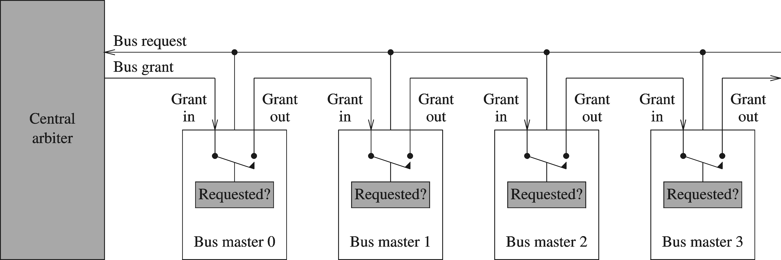
Three problems
  Implements fixed priority
  Arbitration time proportional to number of hosts
  Not fault-tolerant

Slide 29
Independent requests
  Arbiter is connected to each master
  Variety of bus allocation policies can be implemented
  Avoids the pitfalls of daisy-chaining
    Fault-tolerant
    Short, constant arbitration time
  Disadvantages
    Complex to implement
    Number of control signals is proportional to the number of hosts
  PCI uses this implementation technique

Slide 30
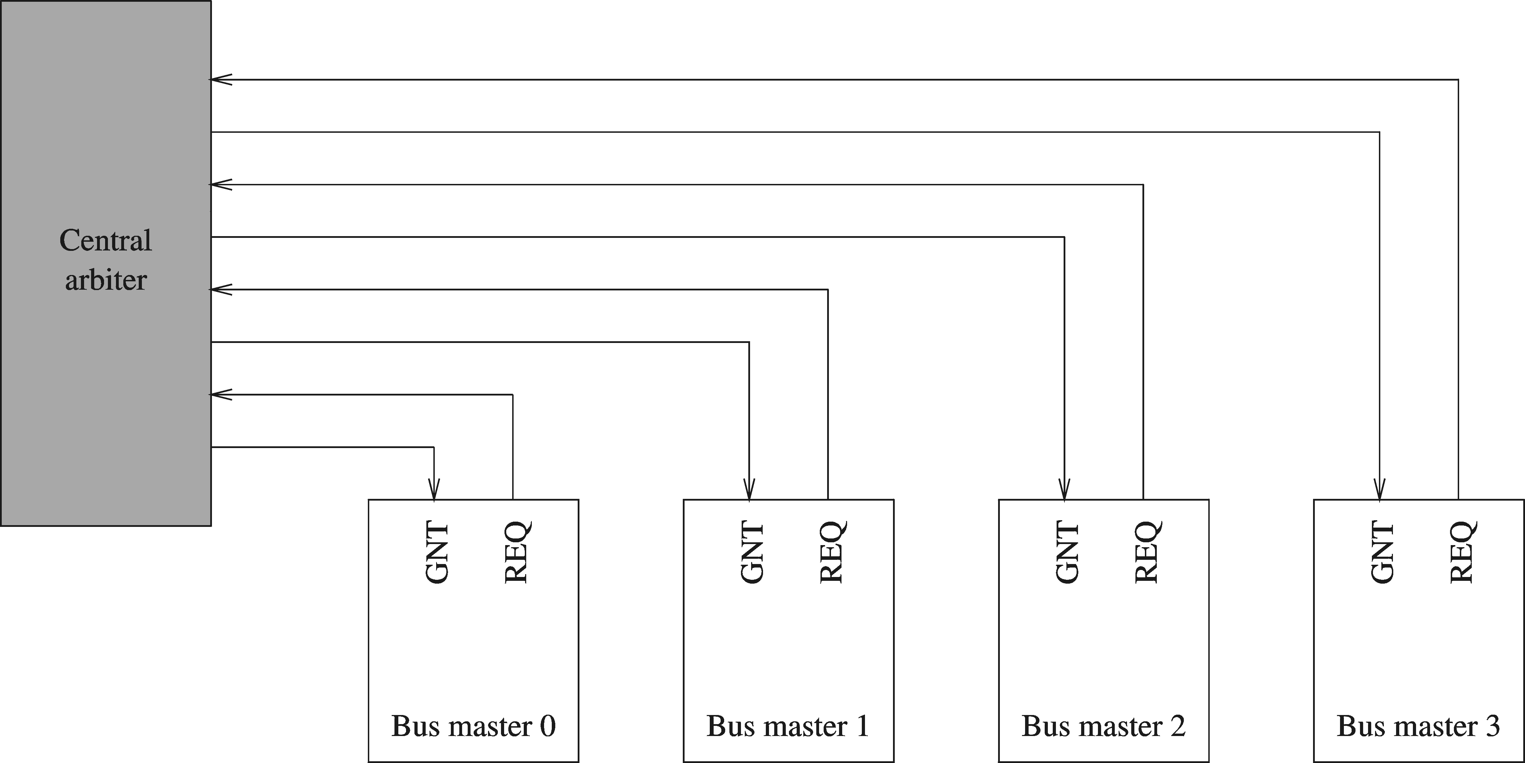

Slide 31
Hybrid scheme
  Daisy-chaining and independent requests represent two extremes
    Daisy-chaining
      Cheaper but several problems
    Independent requests
      Expensive but avoids the problems of daisy-chaining
  Hybrid scheme combines good features of these two
    Bus masters are divided into N classes
    Independent strategy at the class-level
    Daisy-chaining within each class
  VME bus uses a hybrid policy

Slide 32
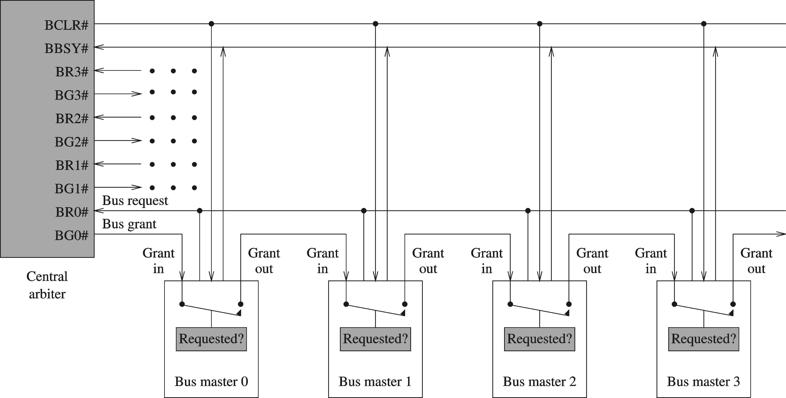
Dynamic Bus Arbitration (cont’d)
VME bus arbitration

Slide 33
Dynamic Bus Arbitration (cont’d)
VME bus arbitration
  Allocation policies supported
    Fixed-priority
      GR0: Lowest priority
      GR3: Highest priority
    Rotating-priority
      Round-robin based policy
        Assigns the lowest priority to the bus that just received the bus
    Daisy-chaining
      Implemented by connecting all masters to BR3 grant request line

Slide 34
Dynamic Bus Arbitration (cont’d)
VME bus arbitration (cont’d)
  Release policies supported
    Default release policy
      Transaction-based
      Non-preemptive
    When fixed priority is used
      Preemptive release is possible when a higher priority request comes in
      To effect preemption
        Bus clear (BCLR) line is asserted
        The current bus master releases the bus when BCLR is low

Slide 35
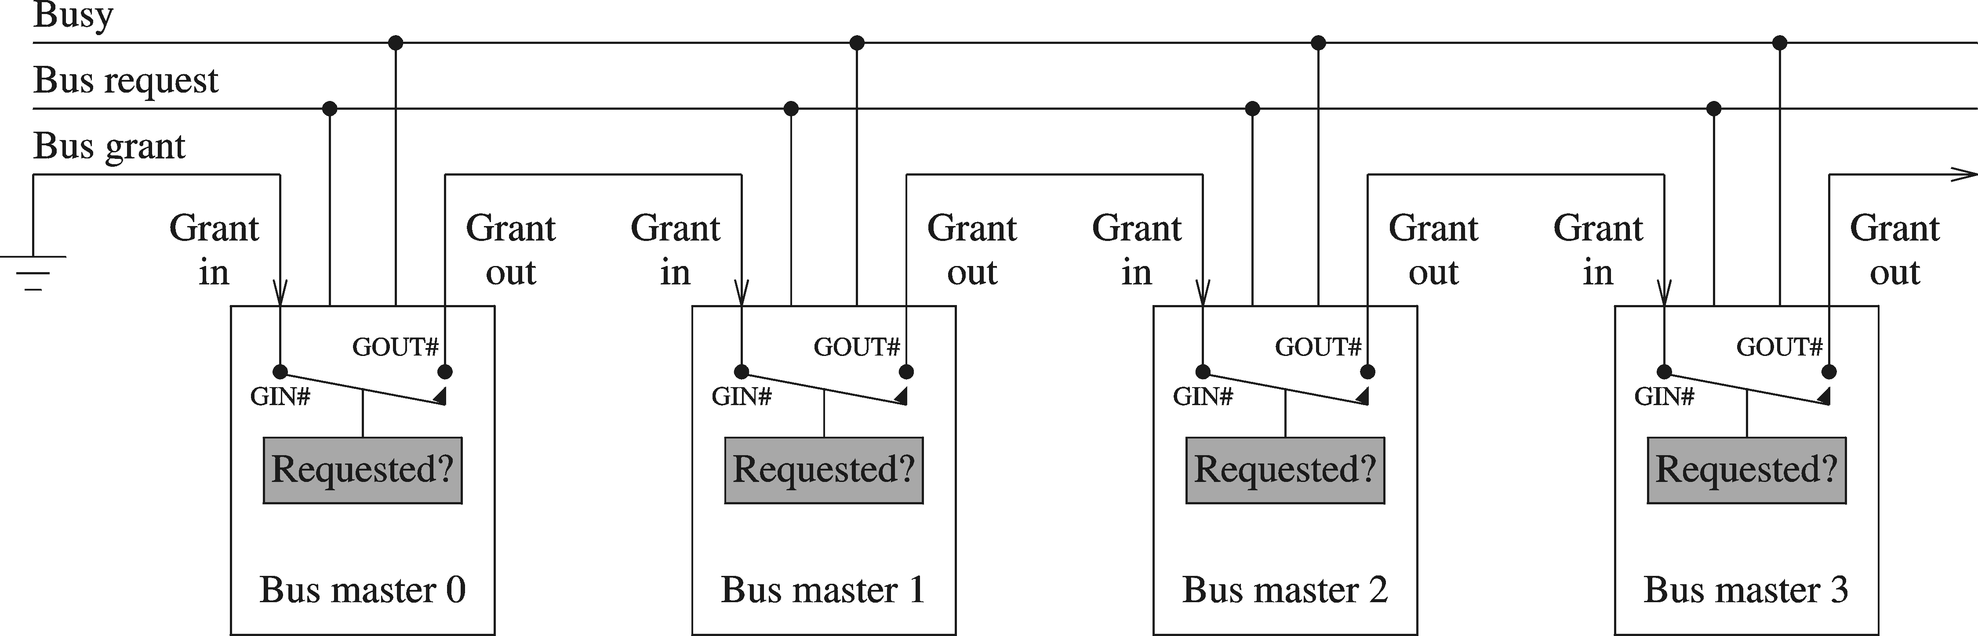
Distributed bus arbitration
  Daisy-chaining
    Needs three control lines as before

Slide 36
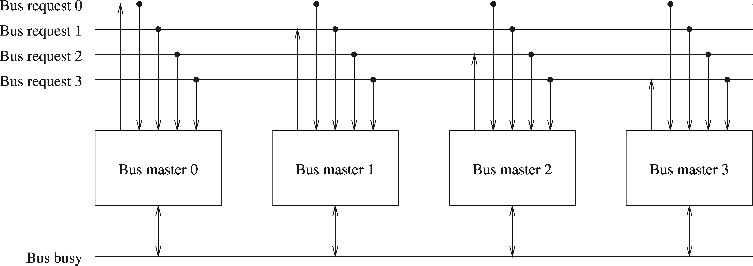
  Separate bus request lines
    All bus masters can read all bus request lines
    Highest priority master gets the bus

Slide 37
  Separate bus request lines (cont’d)
    Implements fixed-priority scheme
    Starvation is a potential problem
    To avoid starvation, a kind of honor system can be used
      The highest-priority master that just used the bus will not raise its bus request until all the other lower priority masters have been allocated the bus

Slide 38
Example Buses
We look at five buses
  ISA
    Supports older text-based applications
  PCI
    Supports modern window-based systems
  AGP
    Supports high-performance graphics and full-motion video
  PCI-X
    Improved and faster PCI
  PCMCIA
    Useful for laptops

Slide 39
ISA Bus
Closely associated with the PC system bus
  ISA = Industry Standard Architecture
First ISA bus (8-bit wide data path)
  Based on 8088 processor
    It had 82 pins including
      20 address lines
      8 data lines
      6 interrupt signals
      Memory read, memory write
      I/O read, and I/O write
      4 DMA requests and 4 DMA acks

Slide 40
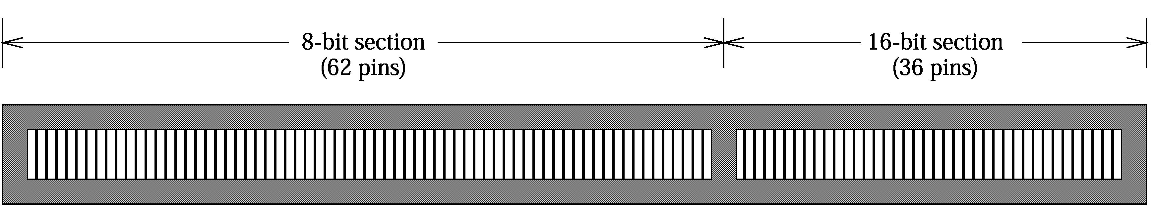
ISA Bus (cont’d)
16-bit ISA
  Added 36 pins to the 8-bit ISA bus
  24 address lines
  16 data lines
  Backward compatible with 8-bit ISA

Slide 41
ISA Bus (cont’d)
Operates at 8.33 MHz
Bandwidth of about 8 MB/s
32-bit processors need more support
  Several attempts were made to accommodate
    EISA (Extended ISA)
      Bus mastering signals
    MCA (Micro Channel Architecture)
      IBM proprietary
      Never really took off
ISA is used for older, slower I/O devices

Slide 42
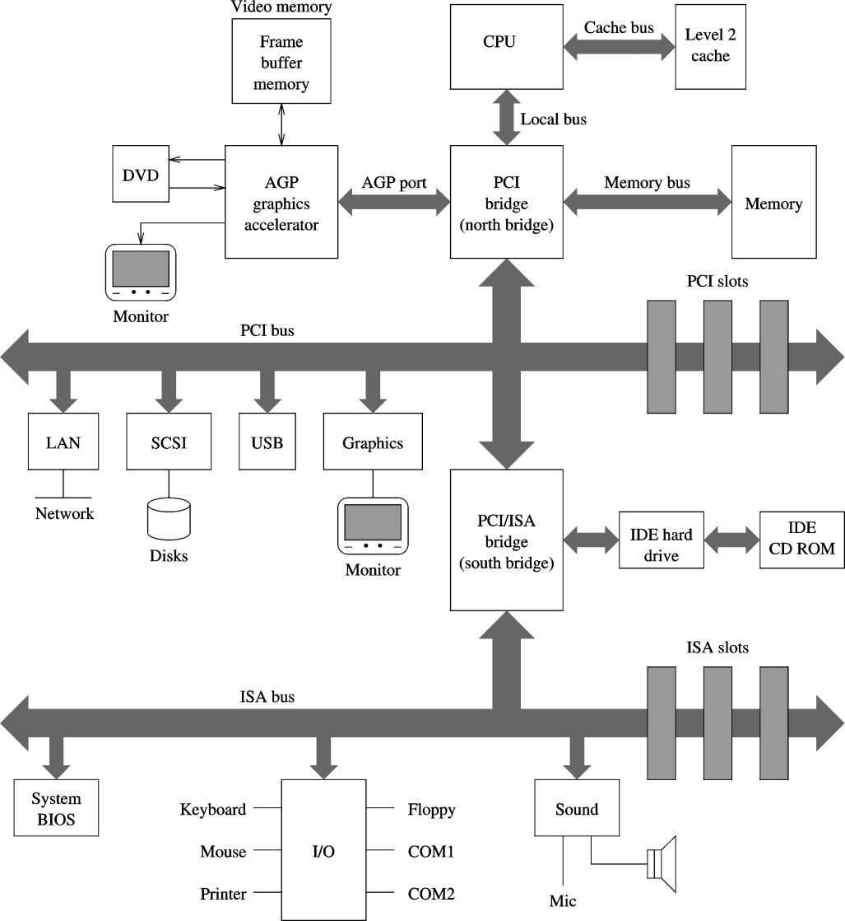
PC System Buses
ISA
PCI
AGP

Slide 43
PCI Bus
Work began in 1990
  Intel began work on a new bus for their Pentium systems
    Processor independent
  To support higher bandwidth requirements of window-based systems
    Original version (1.0) developed by Intel in 1990
    Version 2 in 1993
    Version 2.1 in 1995
    Version 2.2 introduced power management for mobile systems

Slide 44
PCI Bus (cont’d)
Implemented either
  32-bit or 64-bit
Operate at
  33 MHz or 66 MHz
  5 V (older cards) or 3.3 V (newer ones)
32-bit PCI operating at 33 MHz
  Provides peak bandwidth of 133 MB/s
64-bit PCI operating at 66 MHz
  Provides peak bandwidth of 528 MB/s

Slide 45
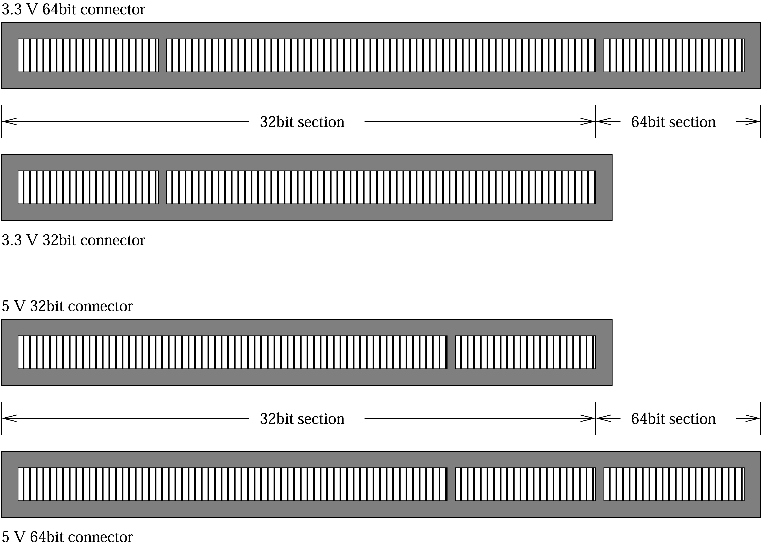
PCI Bus (cont’d)

Slide 46
PCI Bus (cont’d)
Bus signals
  Mandatory signals
    System signals
    Transaction control signals
    Bus arbitration and error reporting signals
  Optional signals
    64 bit extension signals and Interrupt request signals
System signals
  Clock (CLK)
  Reset (RST#)
  Address/Data bus (AD[0-31])
    32 lines multiplexed to serve both address and data buses

Slide 47
PCI Bus (cont’d)
  Command Bus (C/BE#[0-3])
    Multiplexed command and byte enable (BE#) signals
      Command signals identify transaction type
        Memory read, memory write, …
        Asserted during address phase
      BE signals select the bytes to be transferred
        Asserted during data phase
        BE0# identifies byte 0, BE#1 byte 1, …
        0000 = all four bytes
        1111 = none of the bytes (null data phase)
  Parity Signal (PAR)
    Even parity for AD and C/BE lines

Slide 48
PCI Bus (cont’d)
Transaction Control Signals
  Cycle Frame (FRAME#)
    Indicates start of a bus transaction
    Also indicates the length of the bus transaction cycle
  Initiator Ready (IRDY#)
    During Write transaction:
      Indicates the initiator has placed data on AD lines
    During Read transaction:
      Indicates the initiator is ready to accept data
  Target Ready (TRDY#)
    Complements IRDY# signal
    IRDY# and TRDY# together implement handshake to transfer data

Slide 49
PCI Bus (cont’d)
Transaction Control Signals
  Stop Transaction (STOP#)
    Target asserts this to tell initiator that it wants to terminate the current transaction
  Initialization Device Select (IDSEL)
    Used as a chip select for configuration read and write transactions
  Device Select (DEVSEL#)
    Selected target asserts this to tell the initiator that it is present
  Bus Lock (LOCK#)
    Imitator uses this to lock the target to execute atomic transactions

Slide 50
PCI Bus (cont’d)
Bus Arbitration Signals
  Uses centralized bus arbitration with independent request and grant lines
    Bus Request (REQ#)
      A device asserts when it needs the bus
    Bus Grant (GNT#)
      Bus arbiter asserts this signal to indicate allocation of the bus
  Bus arbitration can overlap execution of another transaction
    Improves PCI performance

Slide 51
PCI Bus (cont’d)
Error Reporting Signals
  Parity Error (PERR#)
    All devices are expected to report this error
    Exceptions exist
      E.g. when transmitting video frames
  System Error (SERR#)
    Any PCI device can generate this signal
      To indicate address and other errors
    Typically connected to NMI (non-maskable interrupt)

Slide 52
PCI Bus (cont’d)
64-bit Extension Signals
  Address/Data Lines (AD[32 - 63])
    Extension to 64 bits
  Command bus (C/BE#[4 - 7])
    Extended by 4 lines to handle 8 bytes
  Request 64-Bit Transfer (REQ64#)
    Indicates to target that initiator likes 64-bit transfers
  Acknowledge 64-Bit Transfer (ACK64#)
    Target indicates that it is capable of 64-bit transfers
  Parity Bit for Upper Data (PAR64)
    Even parity for upper 32 AD bits and four command lines

Slide 53
PCI Bus (cont’d)
Interrupt Request Lines
  Four interrupt lines
    INTA#, INTB#, INTC#, INTD#
    Not shared
Additional signals
  To support snoopy cache protocol
  IEEE 1149.1 boundary scan signals
    Allows in-circuit testing of PCI devices
  M66En signal to indicate bus frequency
    Low: 33 MHz
    High: 66 MHz

Slide 54
PCI Commands
A command value is placed on C/BE lines during the address phase
  I/O operations
    I/O Read and I/O Write
  Memory operations
    Standard memory operations
      Memory Read and Memory Write
    Bulk memory operations
      Memory Read Line
      Memory Read Multiple
      Memory Write-and-Invalidate

Slide 55
PCI Commands (cont’d)
Configuration operations
  Every PCI device has a 256-byte configuration space
  Two commands:
    Configuration Read and Configuration Write
Miscellaneous operations
  Special Cycle Command
    Used to broadcast a message to all PCI targets
      Shutdown and Halt
  Dual Address Cycle Command
    Allows 32-bit initiator to use 64-bit addresses
      64-bit address is passed as two 32-bit values

Slide 56
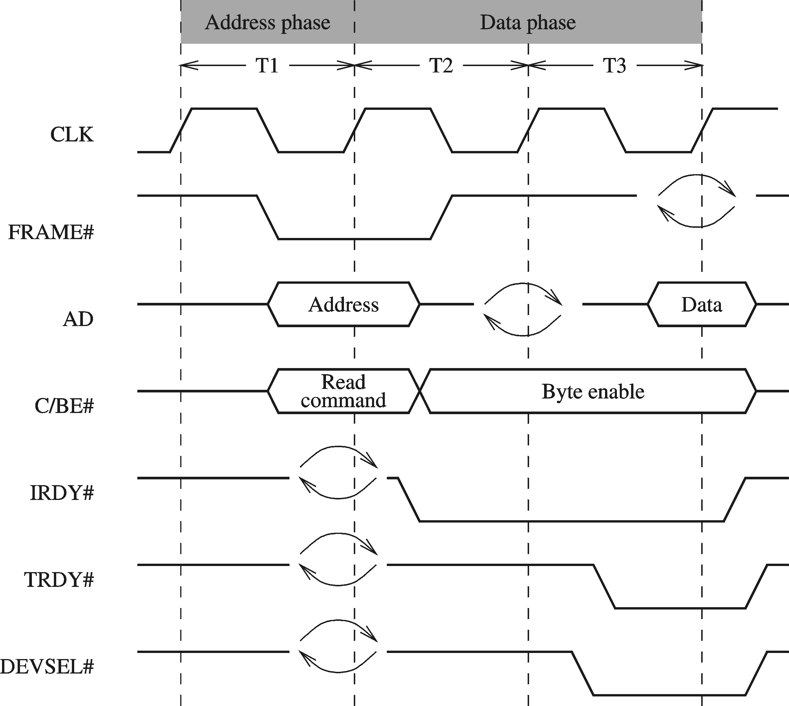
PCI Operations
PCI Read

Slide 57
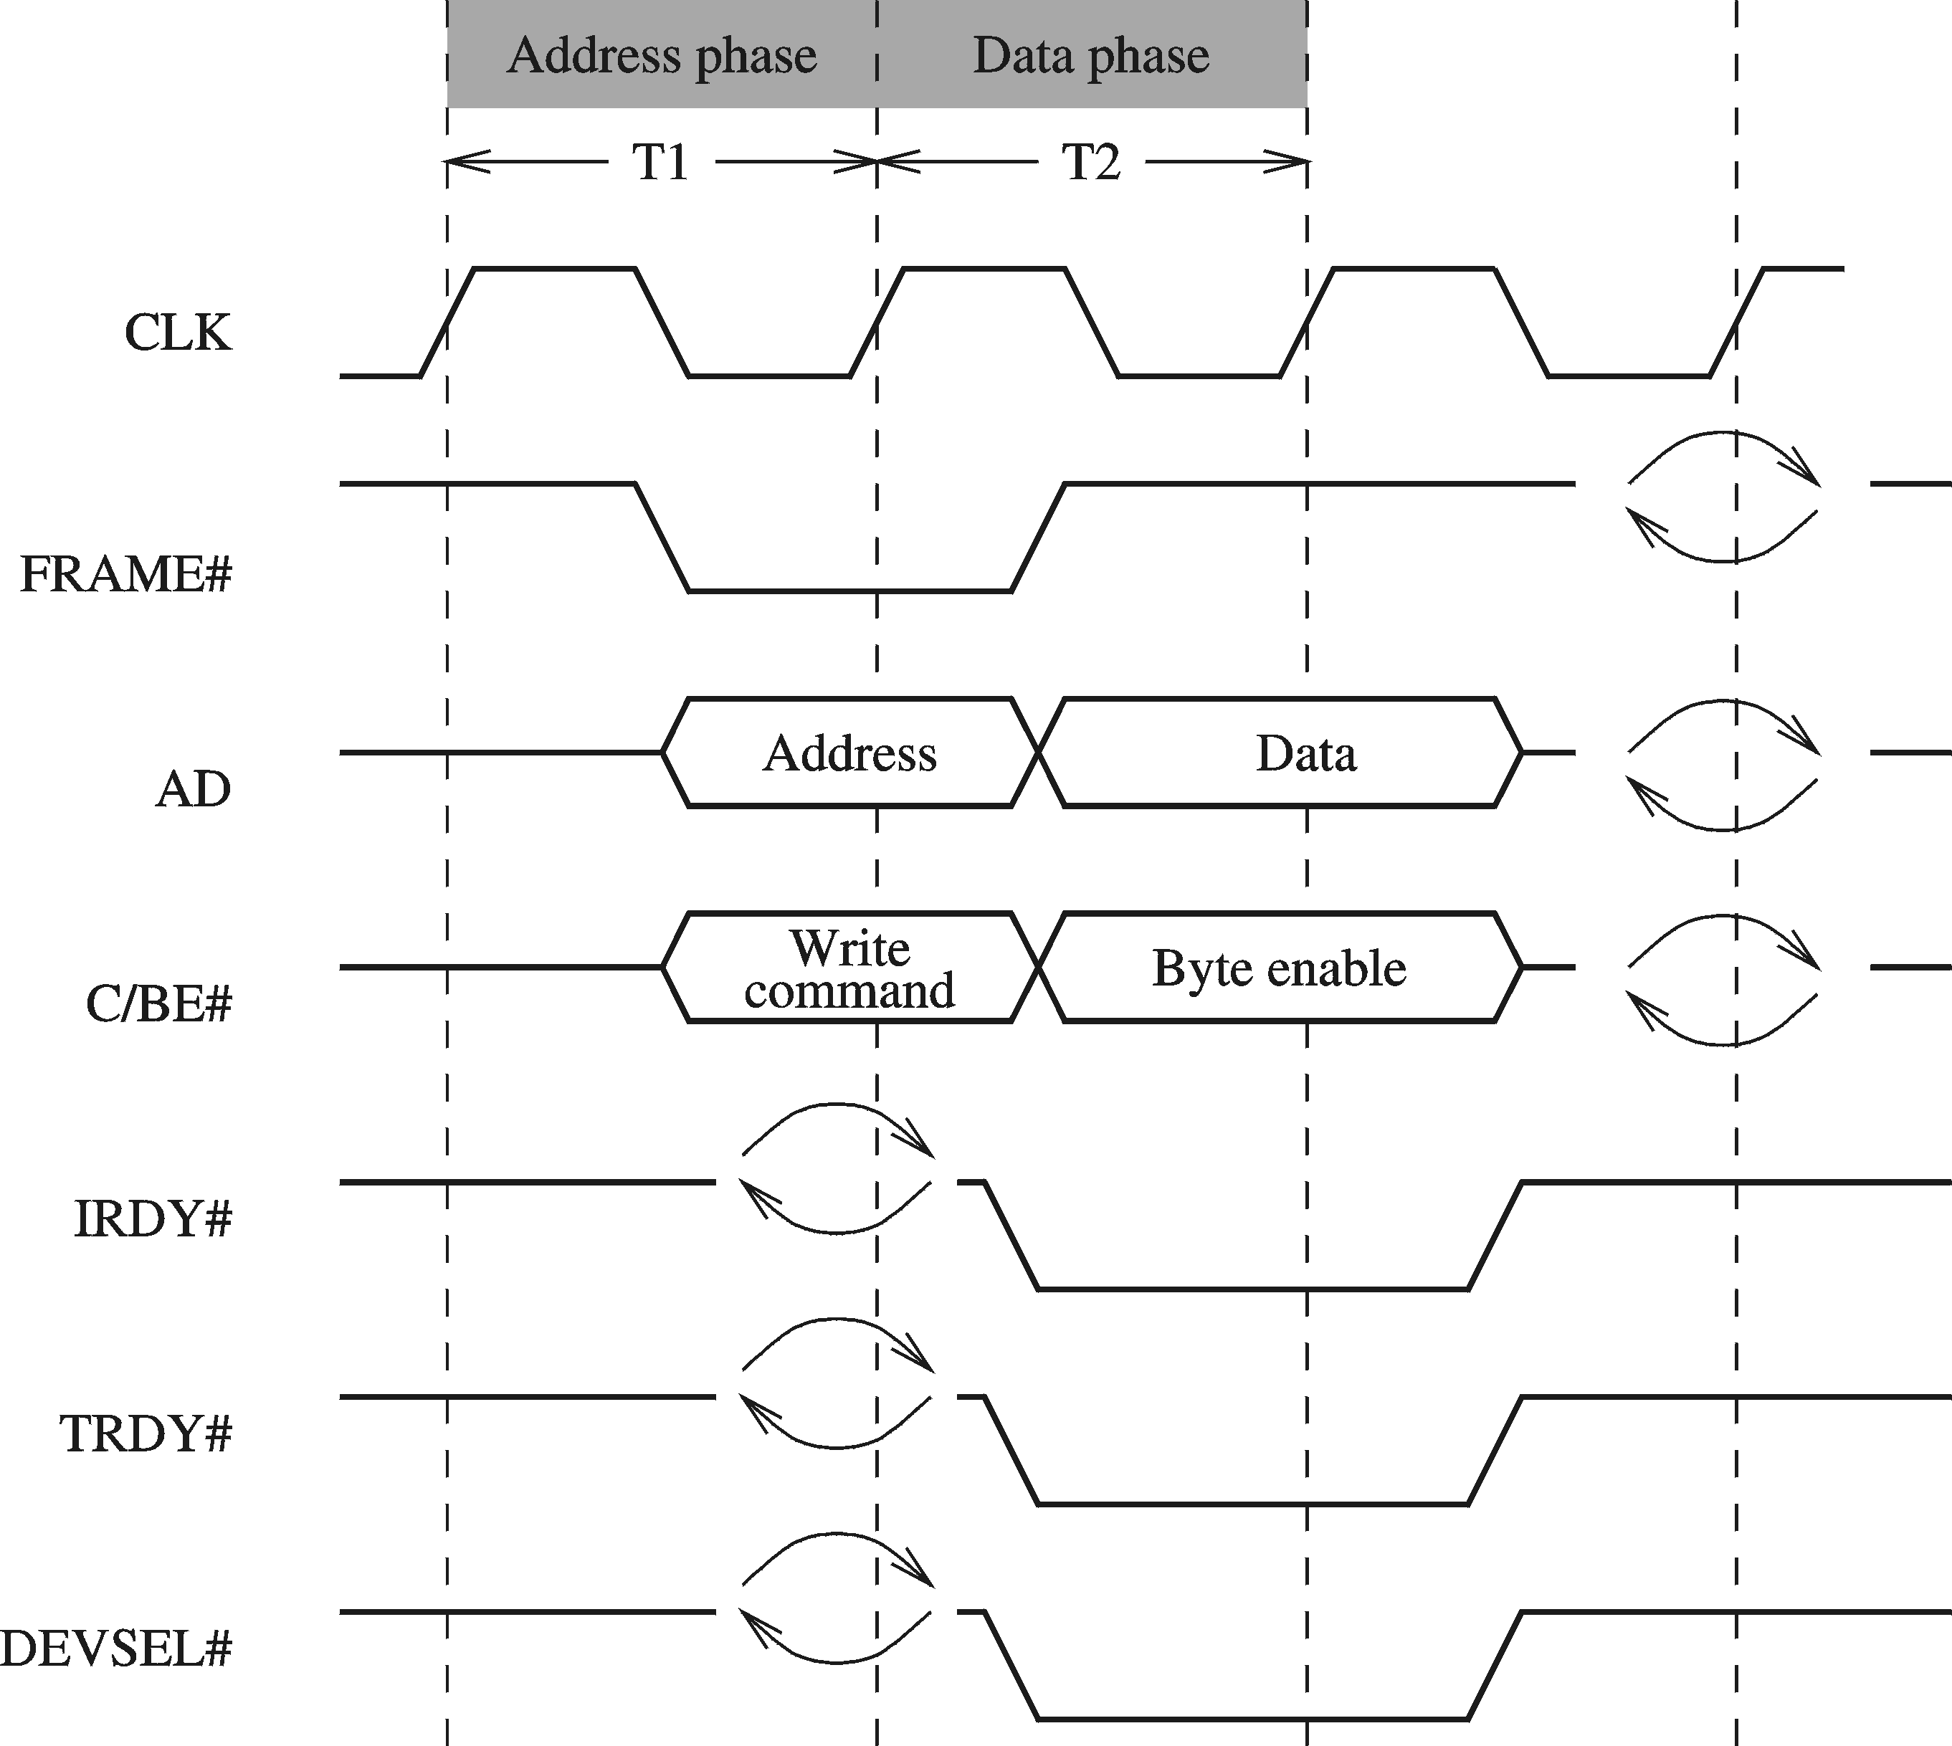
PCI Operations (cont’d)
PCI Write

Slide 58
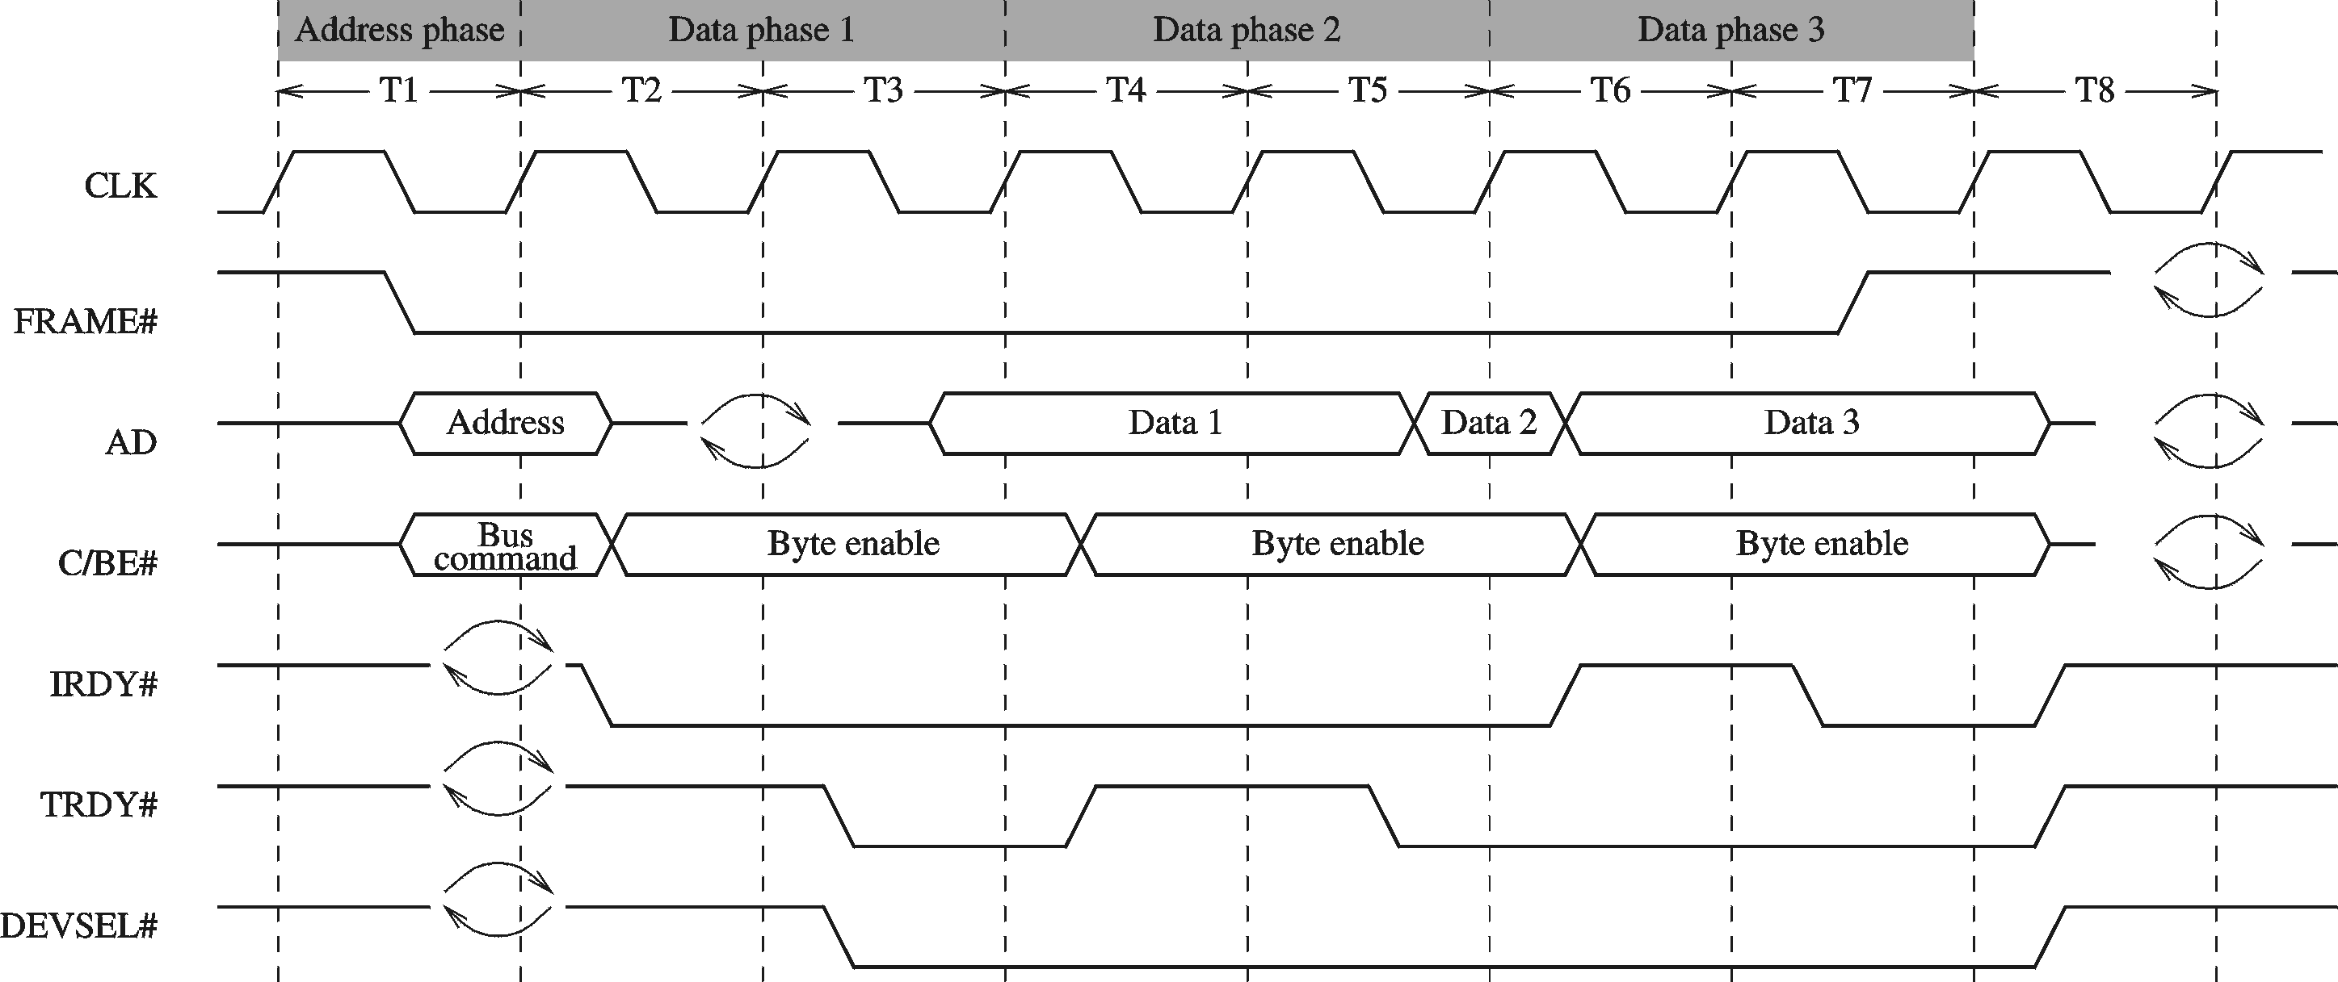
PCI Operations (cont’d)
PCI Burst Read Operation

Slide 59
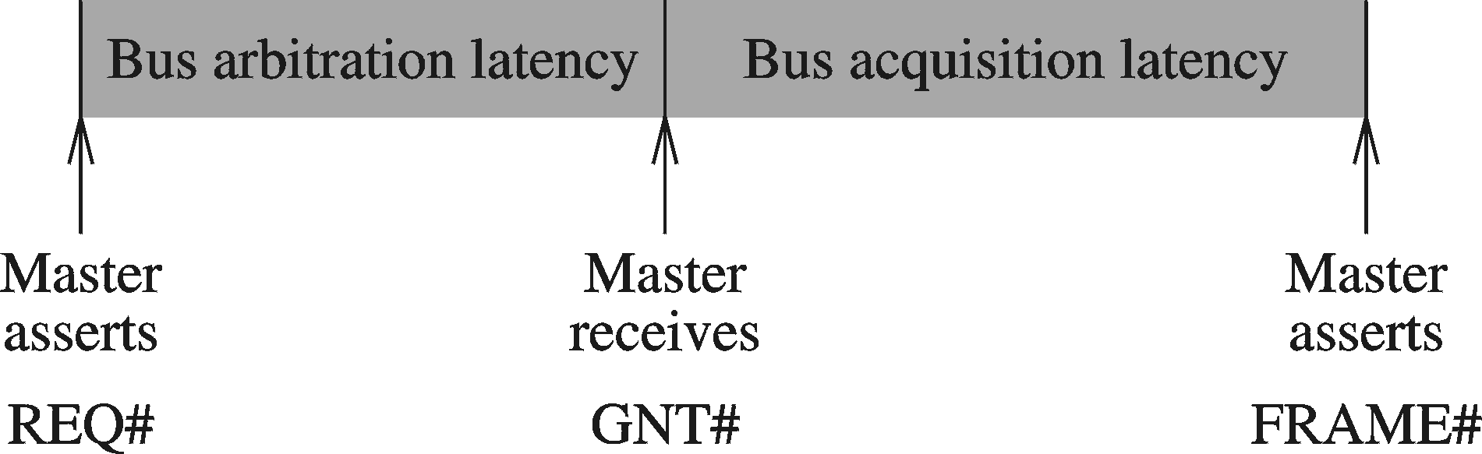
PCI Bus Arbitration
Uses centralized arbitration
  Independent grant and request lines
    REQ# and GNT# lines for each device
  Does not specify a particular policy
    Mandates the use of a fair policy
Two delay components
  Arbitration overlaps with another transaction execution

Slide 60
PCI Bus Hierarchies
Allows bus hierarchies
Built using PCI-to-PCI bridges
  Need two bus arbiters
    One for the primary bus
    One for the secondary bus
Example: Intel 21152 PCI-to-PCI bridge
  Secondary bus can connect up to 4 devices
  One internal arbiter available
    Can be used on the secondary side
  Need external arbiter for the primary side

Slide 61
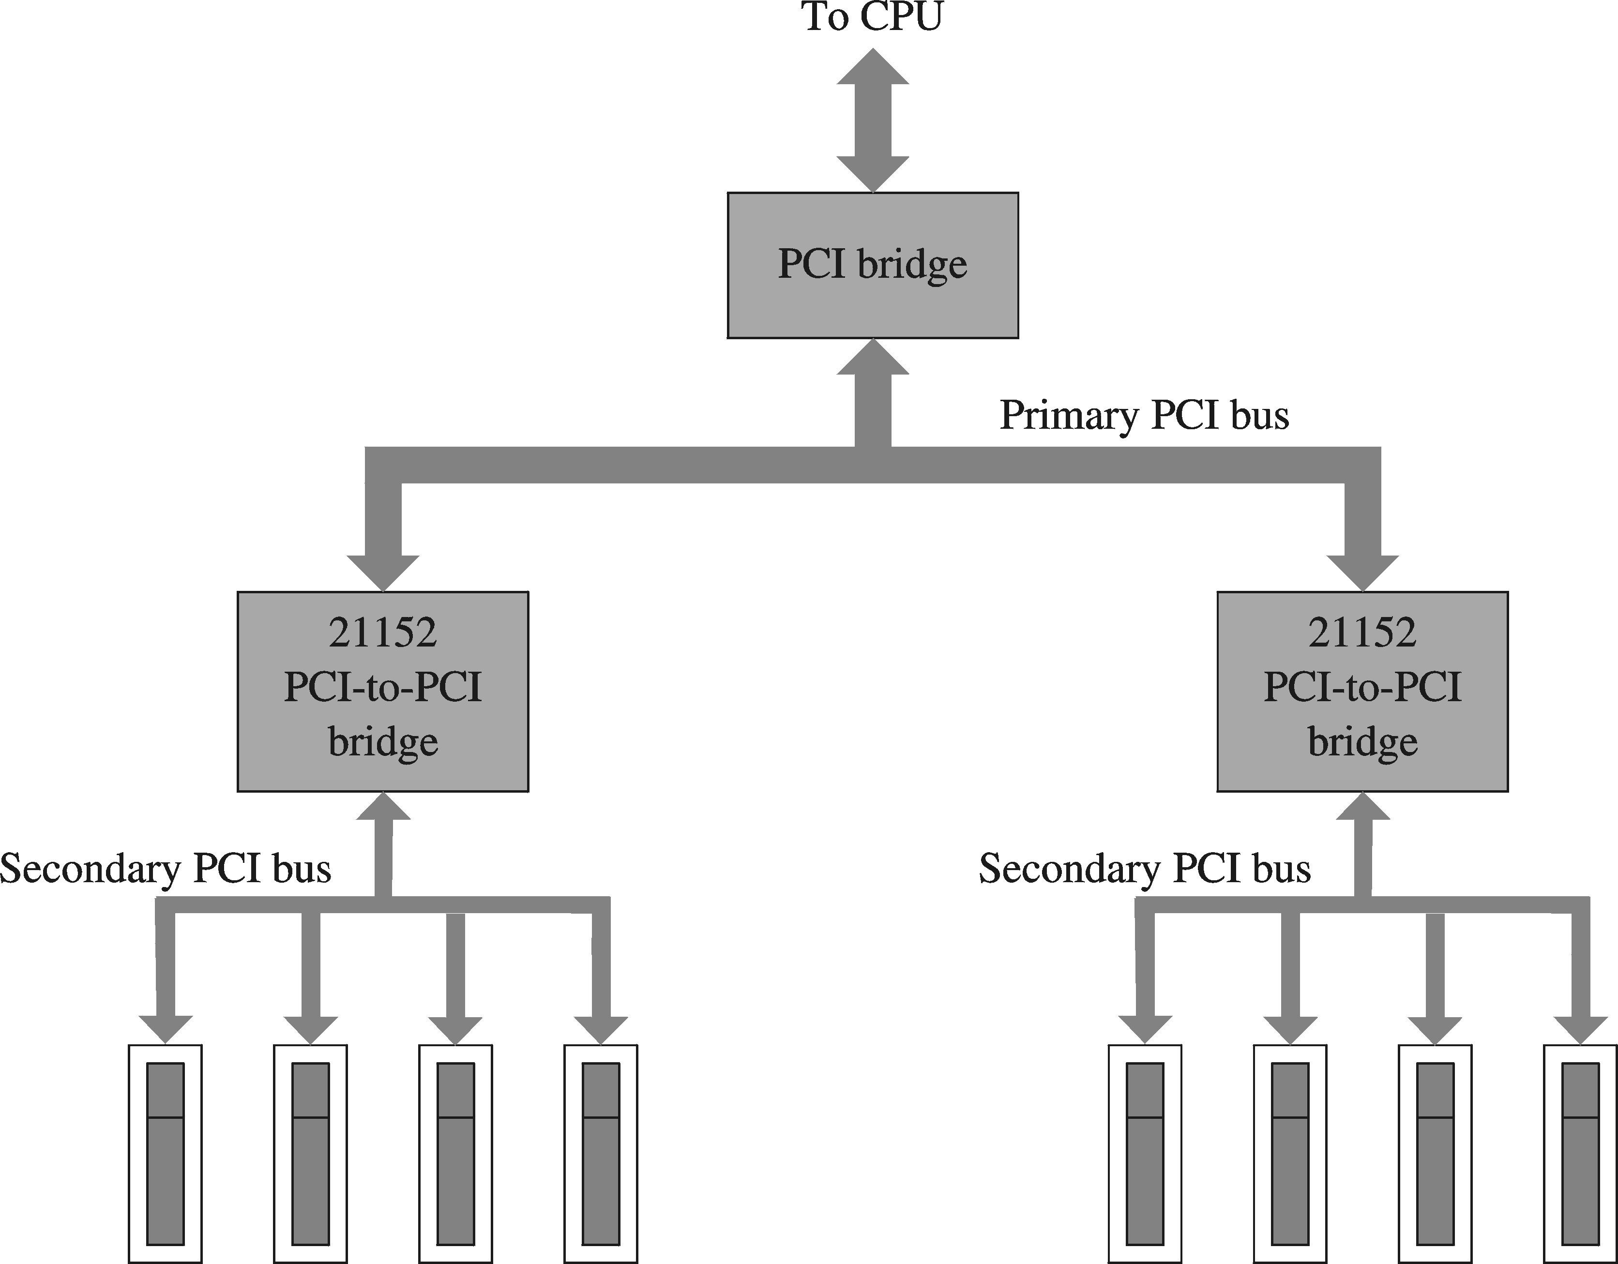
PCI Bus Hierarchies (cont’d)

Slide 62
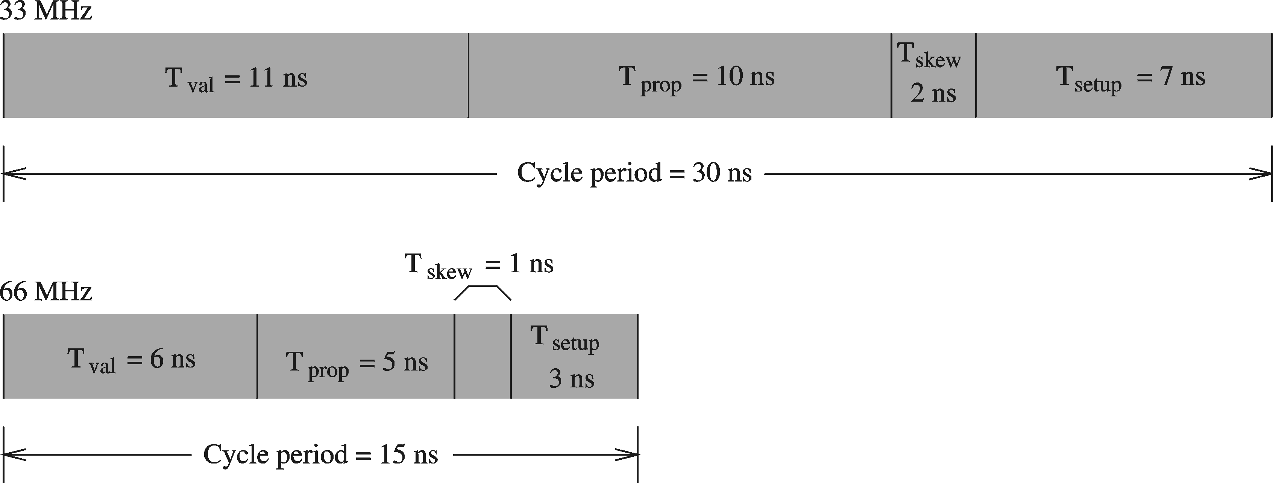
PCI Delays
66 MHz implementations pose serious design challenges
All delays are cut in half compared to 33 MHz clock

Slide 63
AGP
Supports high-performance video
  3D graphics, full-motion video, …
  Takes load off the PCI bus
    Full motion video bandwidth requirement
      640 X 480 resolution: 28 MB/s
      1024 X 768 resolution: 71 MB/s
      Twice this if displaying from DVD or hard disk
  Not a bus, it is a port
    Connects just two devices
      CPU and video card

Slide 64
AGP (cont’d)
AGP specification
    Based on the 66 MHz PCI 2.1 specification
    Retains many of the PCI signals
    2X mode transmits data on the rising as well as falling edge of clock
    4X and 8X speeds are available
Performance enhancements
    Uses pipelining
      Used to hide memory latency
    Sideband addressing
      Used to partially demultiplex the bus

Slide 65
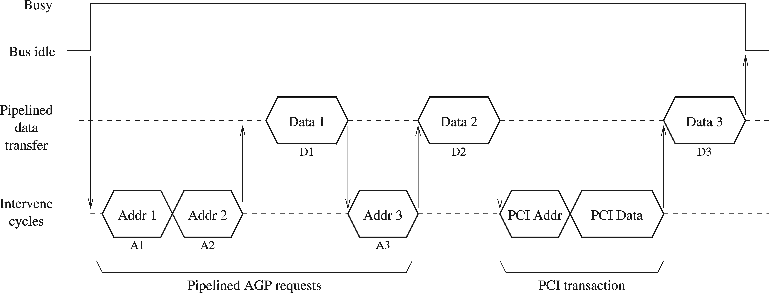
AGP (cont’d)
AGP Pipelined transmission can be interrupted by PCI transactions

Slide 66
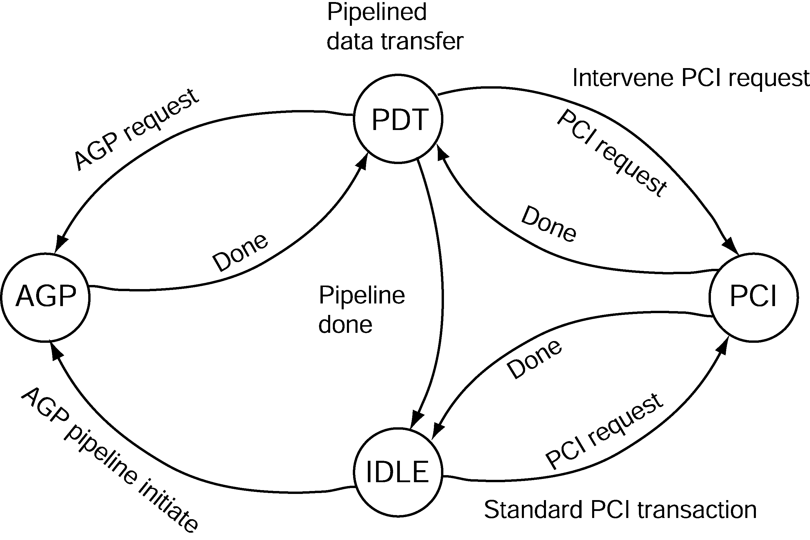
AGP (cont’d)
AGP State Diagram

Slide 67
PCI-X Bus
Addresses the need for higher bandwidth due to
  Faster I/O buses
  Faster networks
Can provide greater than 1 GB/s
  Achieved by using 64-bit bus operating at 133 MHz
Uses register-to-register protocol
Can operate at three different frequencies
  66 MHz
  100 MHz
  133 MHz

Slide 68
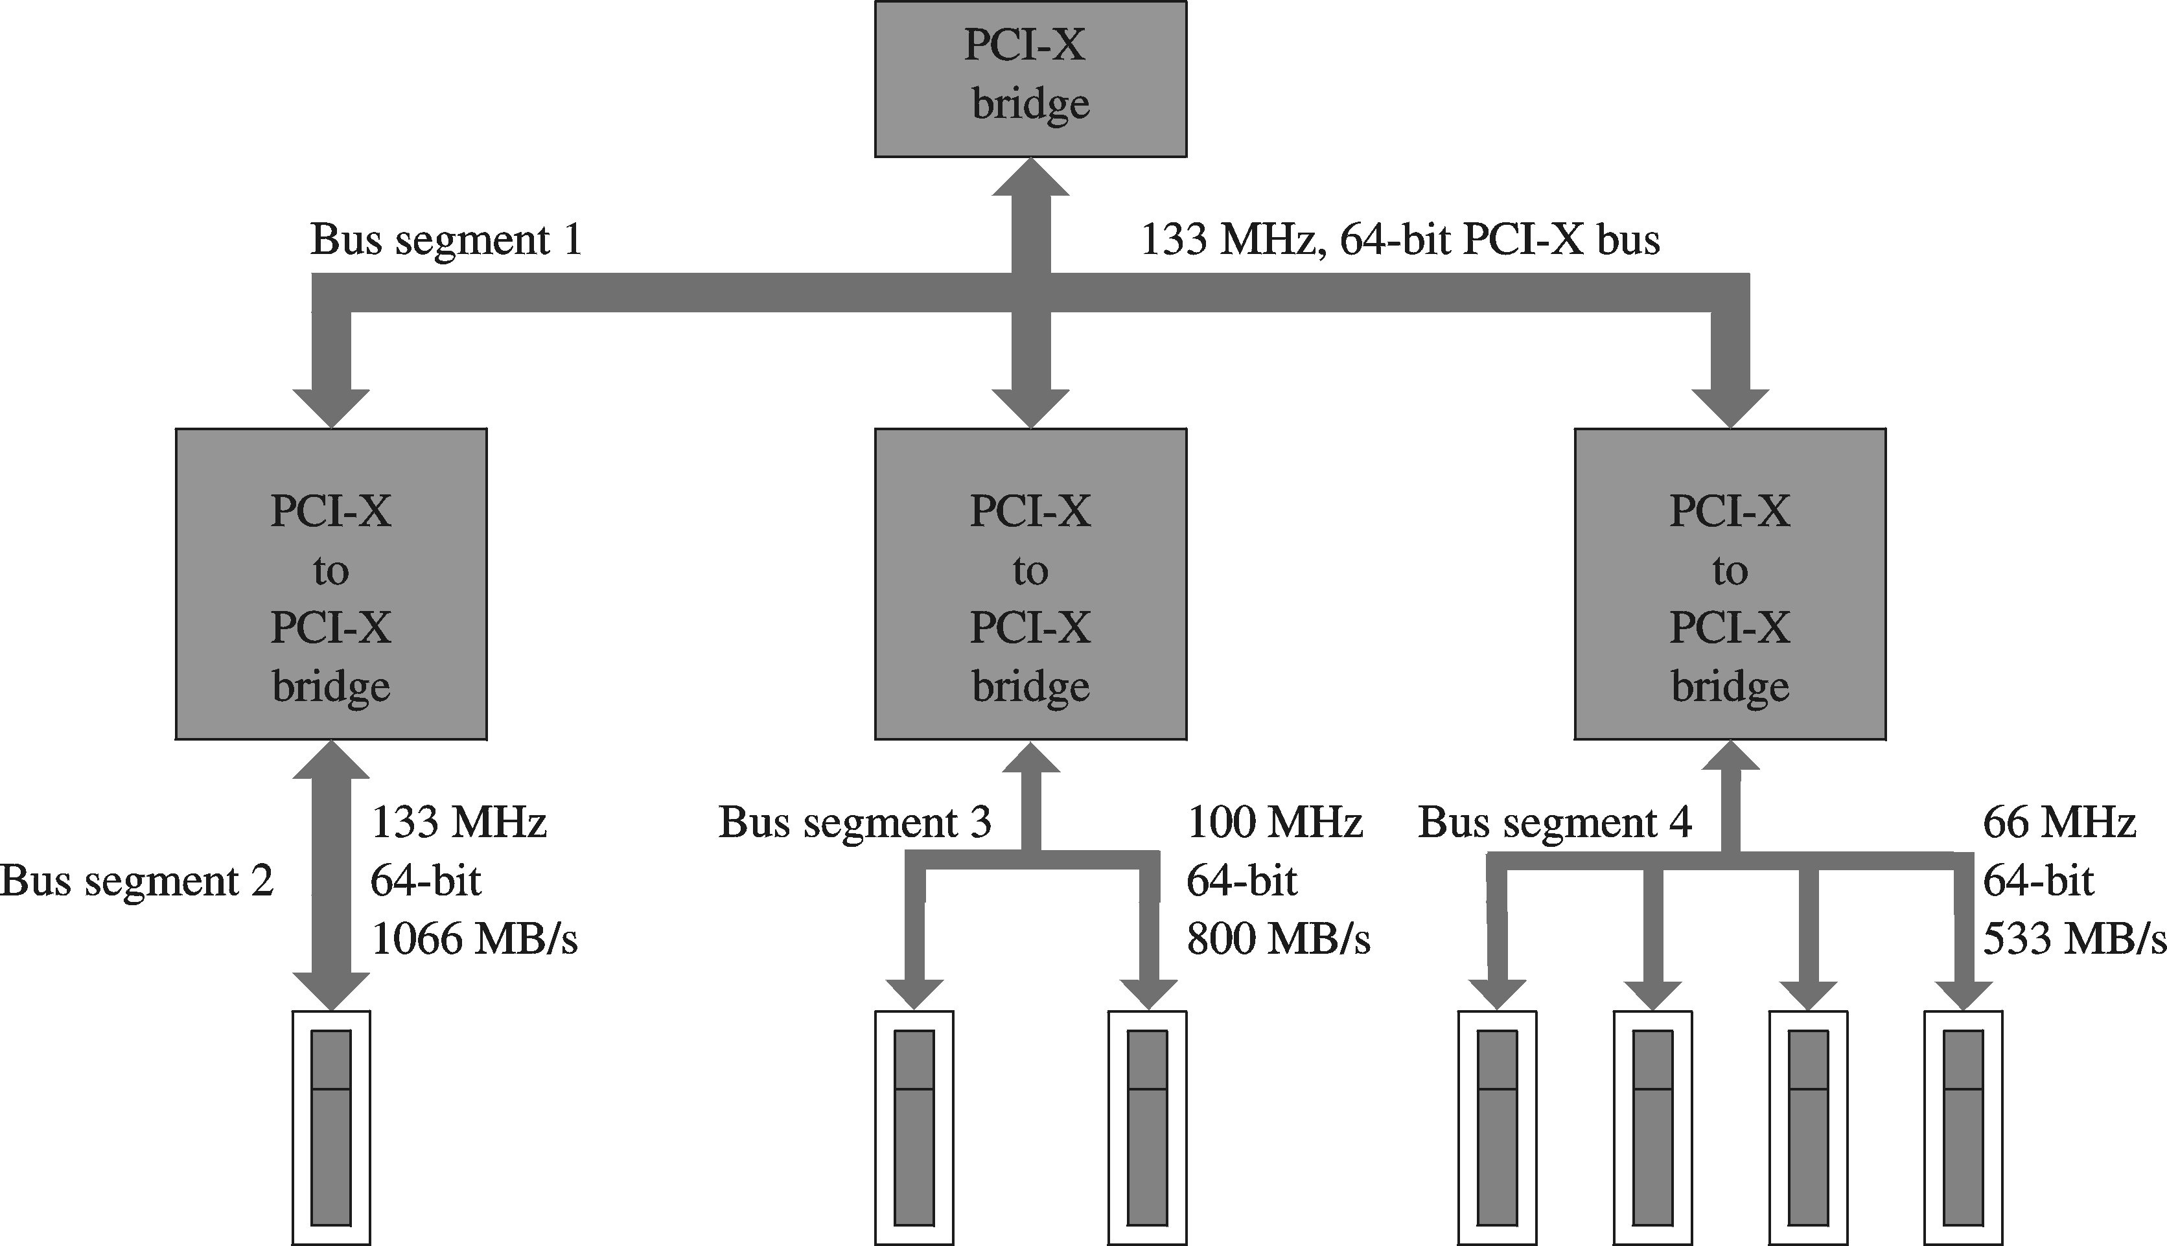
PCI-X Bus (cont’d)

Slide 69
PCI-X Bus (cont’d)
Enhancements include
  Attribute phase
    Describes the transaction in more detail than PCI
      Transaction size, relaxed transaction ordering, identity of transaction initiator
  Split transaction support
    PCI: Treats request and reply as a single transaction
    PCI-X: Splits them into two transactions
  Optimized wait states
    Bus can be released due to split transaction support
  Standard block size movement

Slide 70
PCMCIA Bus
Started as a standard for memory cards
    PCMCIA = Personal Computer Memory Card International Association
      Also called PC Card standard
    First standard (version 1.0) released in 1990
    Release 2.0 also supports I/O devices
    Small form factor
      85.5 mm X 54 mm (credit card size)
    Thickness varies
      Type I: 3.3 mm thick (used for memory)
      Type II: 5 mm thick (I/O devices---modems, NICs)
      Type III: 10.5 thick (I/O devices --- hard drives…)

Slide 71
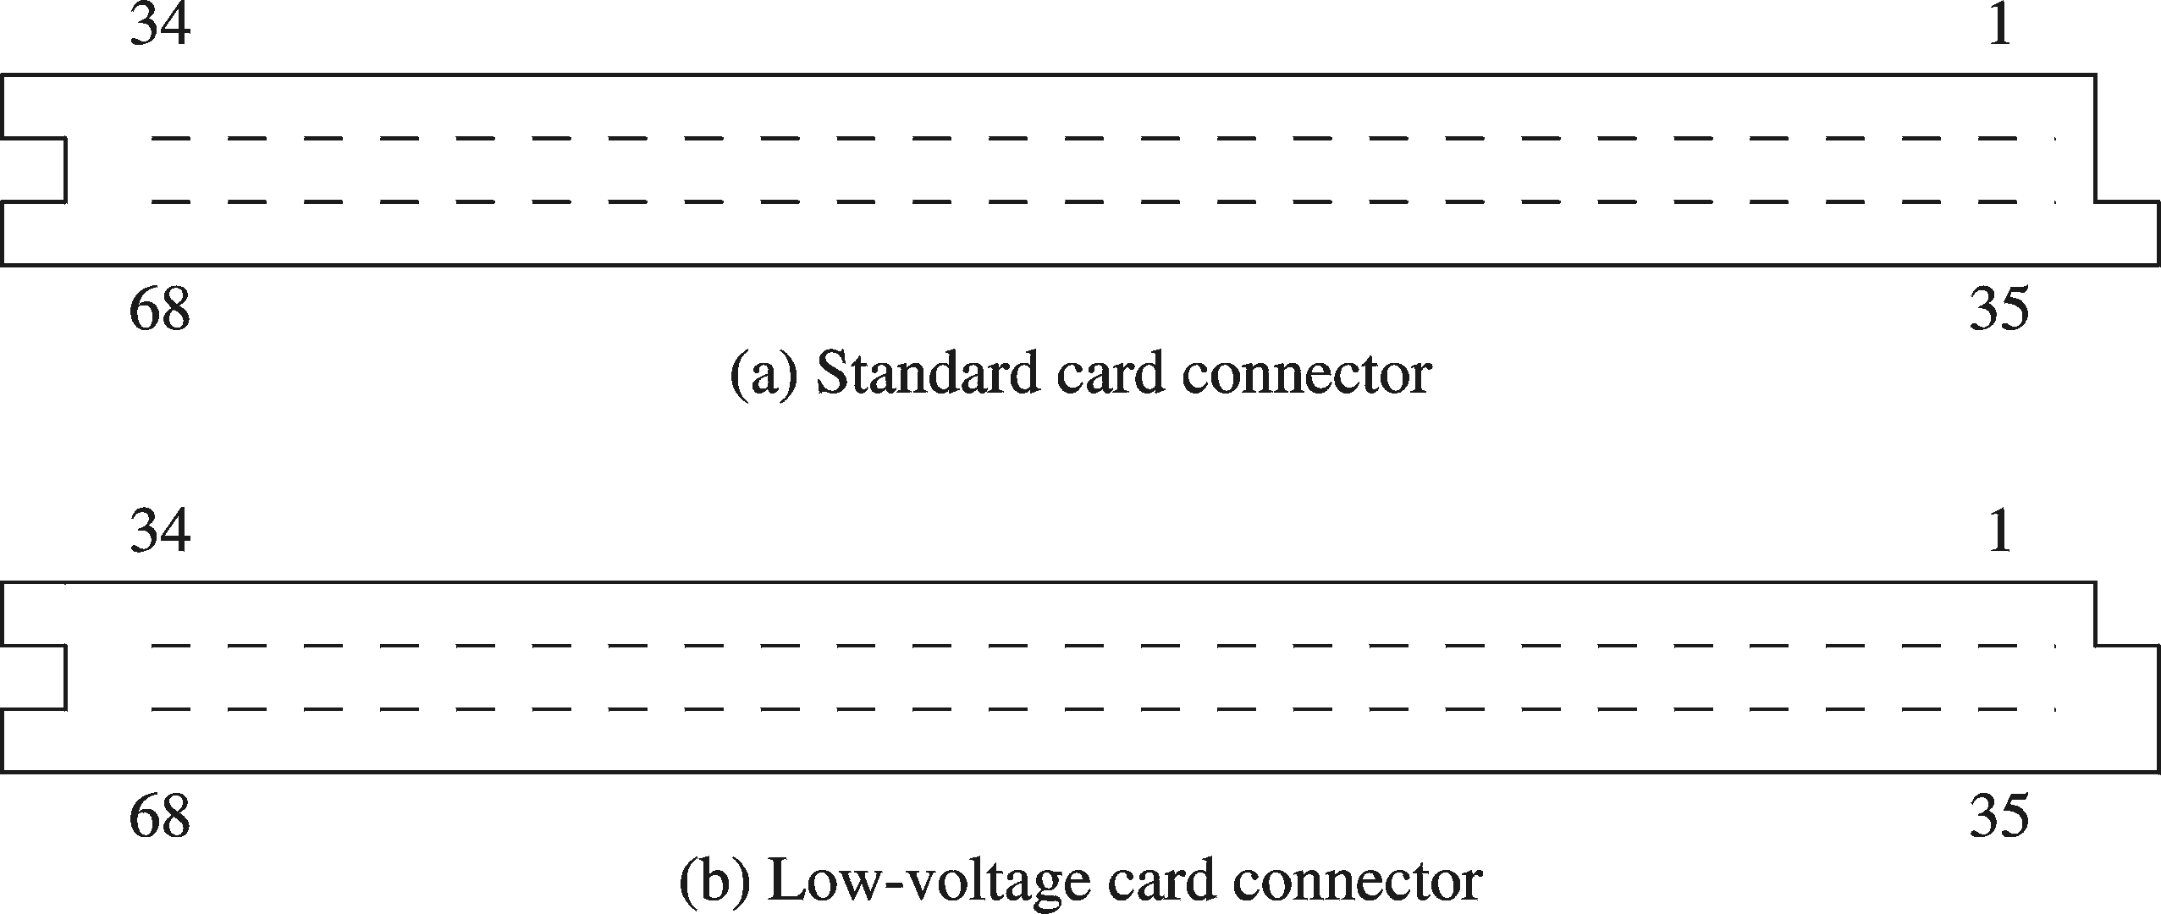
PCMCIA Bus (cont’d)
PCMCIA connectors (68 pins)
  Sockets are keyed such that low-voltage card cannot be inserted into a 5 V standard socket

Slide 72
PCMCIA Bus (cont’d)
PCMCIA supports three address spaces
  Common address space (64 MB)
    Used for memory expansion
  Attribute address space (64 MB)
    Used for automatic configuration
  I/O address space
    I/O devices use either Type II or III card
PC card uses 16-bit data bus
Also defines a 32-bit standard
  It is called CardBus

Slide 73
PCMCIA Bus (cont’d)
Memory Interface
  Address signals
    Address lines (A0 – A25)
      Support 64 MB of address space
    Card Enable Signals (CE1#, CE2#)
      Similar to chip select
      Controls data transfer
        CE1 = CE2 = High : No data transfer
        CE1 = low, CE2 = High : Data transfer lower data path (D0 – D7)
        CE1 = high, CE2 = low : Data transfer upper data path (D8 – D15)
        CE1 = CE2 = low : 16-bit data transfer (D0 – D15)

Slide 74
PCMCIA Bus (cont’d)
Four types of memory
transactions:
Common memory read
Common memory write
Attribute memory read
Attribute memory write
Memory Interface
  Transaction Signals
    Data lines (D0 – D15)
      Used to transfer data
    Output Enable (OE#)
      Memory read signal
    Write Enable (WE#)
      Memory write signal
    Wait Signal (WAIT#)
      Can be use to extend the transaction cycle
    Register Select (REG#)
      Used to select common memory (high) or attribute memory (low)

Slide 75
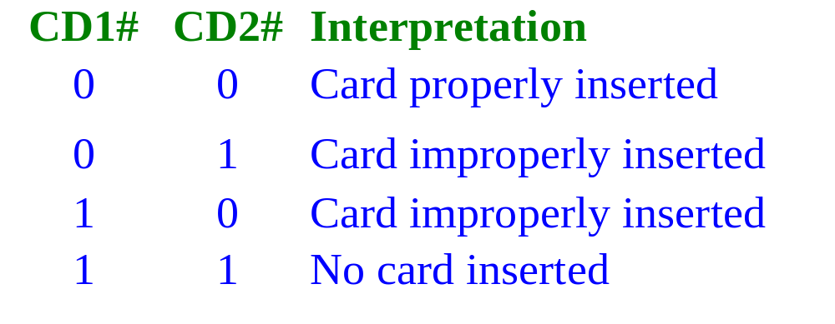
PCMCIA Bus (cont’d)
  Memory Card Status Signals
    Card Detect Signals (CD1#, CD2#)

Slide 76
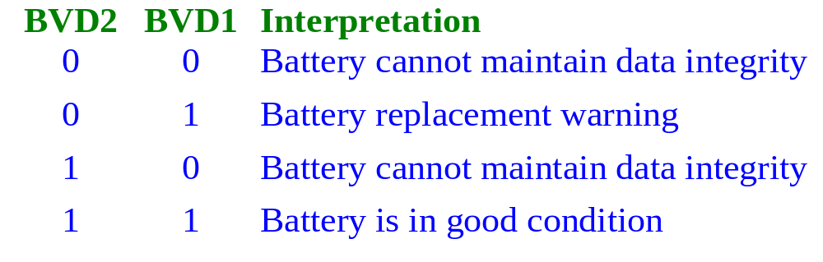
PCMCIA Bus (cont’d)
  Ready/Busy Signal (READY)
    High: indicates the card is ready to be accessed
    Low: Busy executing a command
  Write Protect (WP)
    Gives status of the write protect switch on the card
  Battery Voltage Detect Signals (BVD1, BVD2)

Slide 77
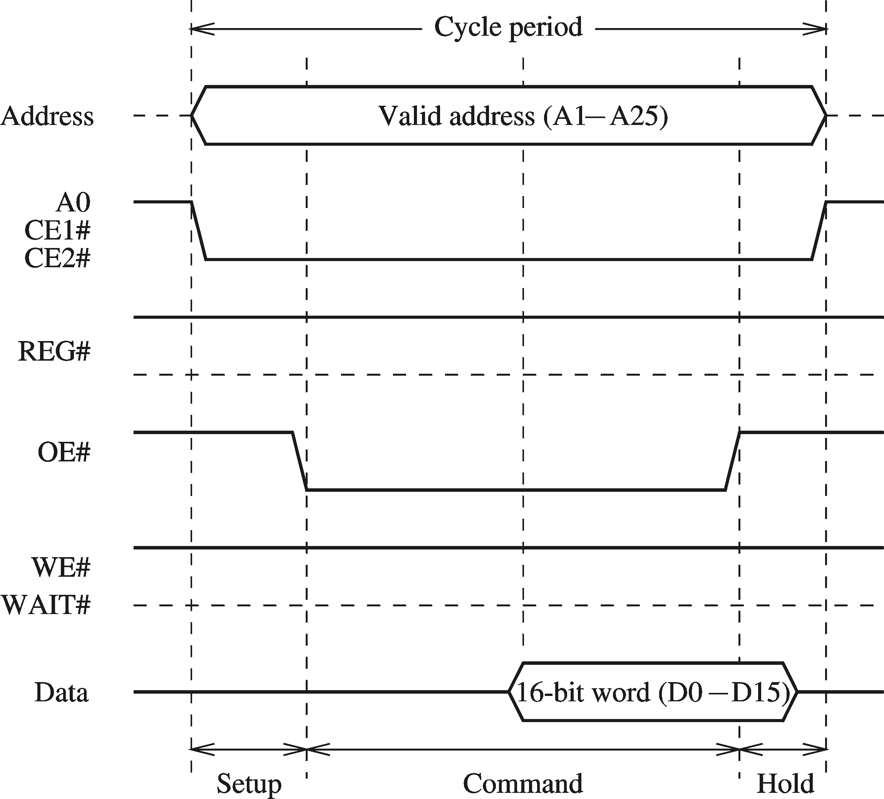
PCMCIA Bus (cont’d)
16-bit Common memory read cycle
No wait states

Slide 78
PCMCIA Bus (cont’d)
I/O Interface
  Uses Type II or III card
    Some memory signals are changed for I/O interfacing
    Some reserved signals are also used for I/O interfacing
  I/O Read and Write (IORD#, IOWR#)
    Reserved in memory interface
  Interrupt Request (IREQ#)
    Replaces memory READY signal
    PC card asserts to request interrupt service

Slide 79
PCMCIA Bus (cont’d)
  I/O Size is 16 Bits (IOIS16#)
    Replaces Write Protect memory signal
    Low: Indicates I/O is a 16-bit device
    High: Indicates I/O is a 8-bit device
  System Speaker Signal (SPKR#)
    Sends audio signal to system speaker
  I/O Status Change (STSCHG#)
    Replaces BVD1 memory signal
    Useful in multifunction PC cards
      Containing memory and I/O functions

Slide 80
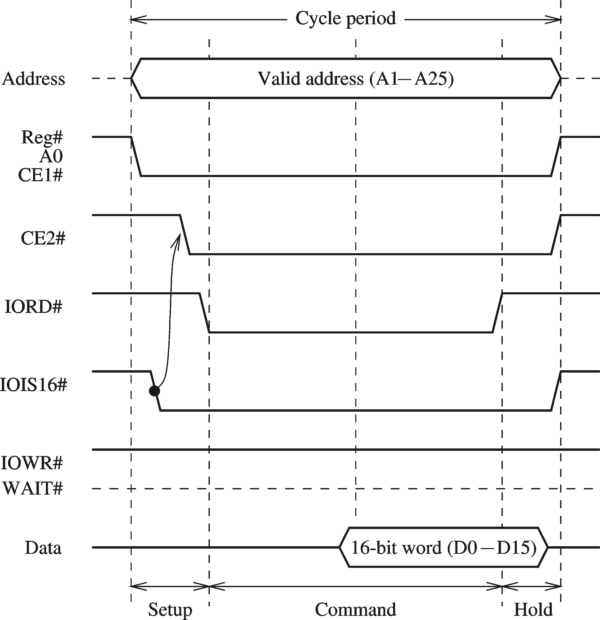
PCMCIA Bus (cont’d)
16-bit I/O read cycle
No wait states
Last slide

